Slide 1


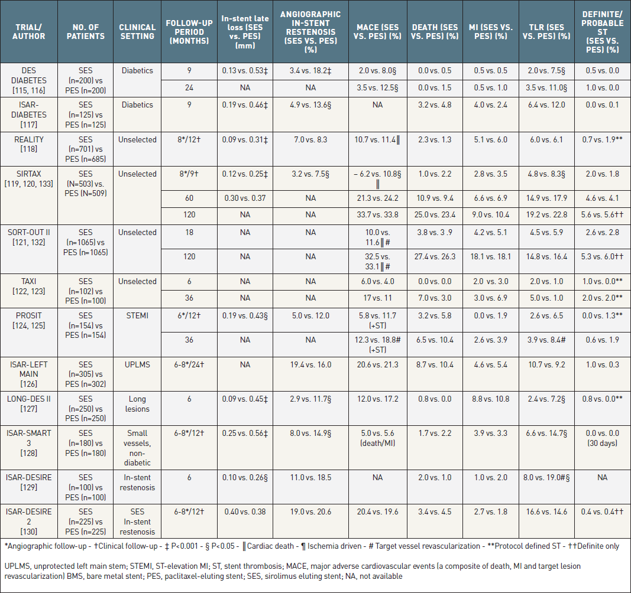

Coronary artery stents (old)
Table 6
Summary of major randomized trials (>100 patients in each group) comparing the sirolimus-eluting stent to the paclitaxel eluting stents in different clinical settings. Differences are non-significant unless indicated. Stent thrombosis ARC definition unless indicated.
Scot Garg, Sharmaine Thirunavukarasu, Raffaele Piccolo, Patrick W. Serruys, Stephan Windecker
©2025 Europa Group - All rights reserved.

