Slide 1


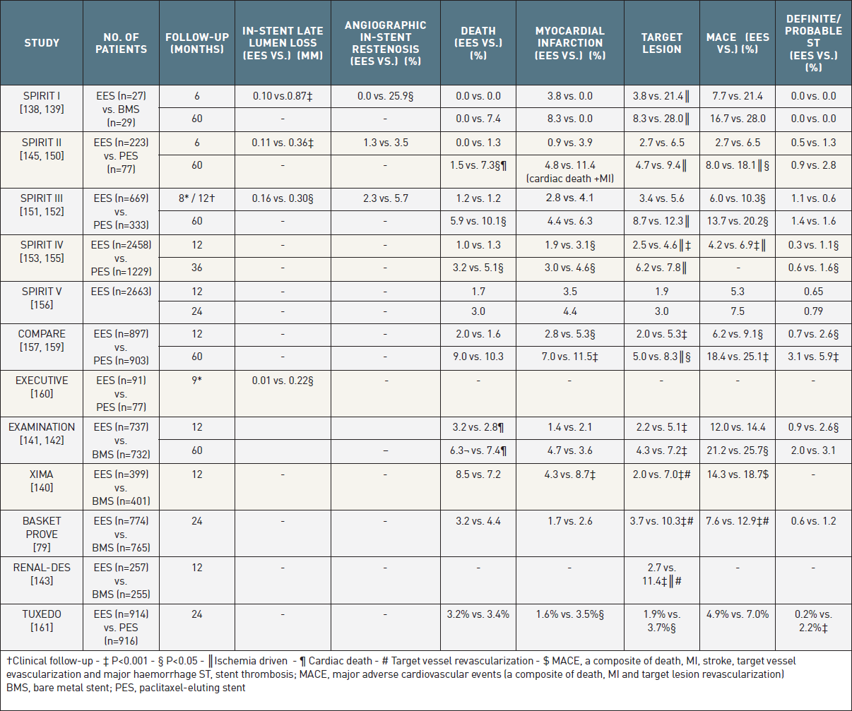

Coronary artery stents (old)
Table 7
The most prominent randomized trials comparing the 2nd generation everolimus-eluting stent to the bare-metal stent and to the paclitaxel-eluting stent. Differences non-significant unless indicated.
Scot Garg, Sharmaine Thirunavukarasu, Raffaele Piccolo, Patrick W. Serruys, Stephan Windecker
©2025 Europa Group - All rights reserved.

