Slide 1


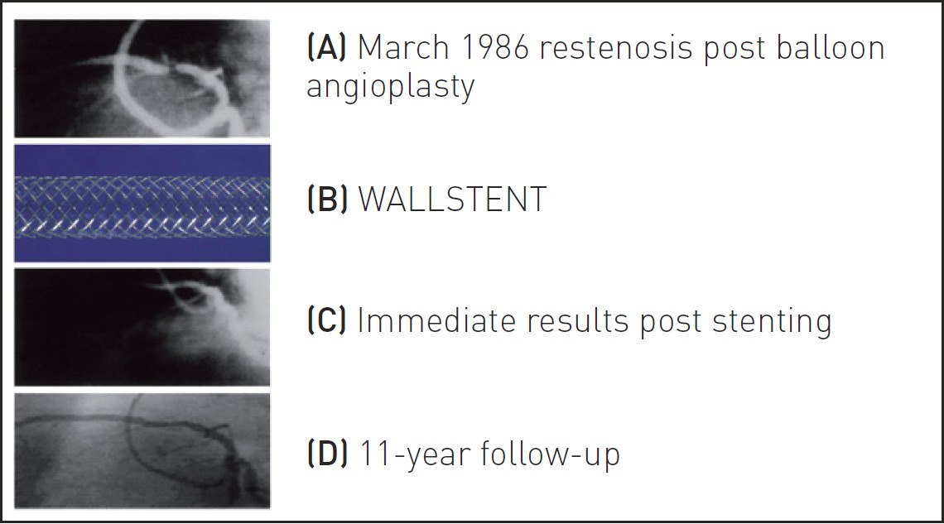

Coronary artery stents
Figure 1
First human coronary stent implantation in March 1986. (a) Restenosis post balloon angioplasty (b) Self-expanding WALLSTENT (c) Immediate results post stent (d) Angiographic results at 11-year follow-up.
Miklos Rohla, Scot Garg, Raffaele Piccolo, Sharmaine Thirunavukarasu, Patrick W. Serruys, Stephan Windecker
©2025 Europa Group - All rights reserved.

