Slide 1


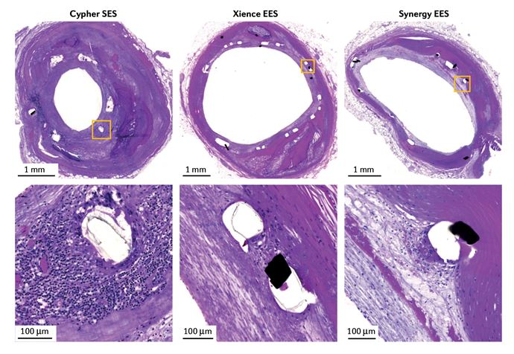

Coronary artery stents
Figure 10
Histological study of the inflammatory reaction to first- and newer-generation drug-eluting stents. Representative histological images of the Cypher sirolimus-eluting stent (SES), Xience everolimus-eluting stent (EES) and Synergy EES in human coronary arteries. Note the excessive inflammation associated with the Cypher SES, whereas the inflammatory reaction with the Xience EES and Synergy EES is minimal. Reproduced with permission from the publisher [63184]
Miklos Rohla, Scot Garg, Raffaele Piccolo, Sharmaine Thirunavukarasu, Patrick W. Serruys, Stephan Windecker
©2025 Europa Group - All rights reserved.

