Slide 1


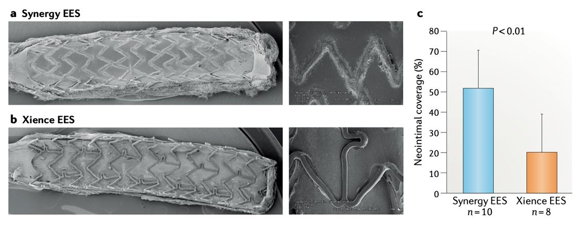

Coronary artery stents
Figure 11
Neointimal coverage of a biodegradable polymer and durable polymer DES, implanted in pig coronary arteries. a) and a Xience EES (part b) at 3 days after implantation in rabbit iliac arteries. c | The percentage of neointimal coverage is significantly higher with the Synergy EES than with the Xience EES. Reproduced with permission of the publisher [63184]
Miklos Rohla, Scot Garg, Raffaele Piccolo, Sharmaine Thirunavukarasu, Patrick W. Serruys, Stephan Windecker
©2025 Europa Group - All rights reserved.

