Slide 1


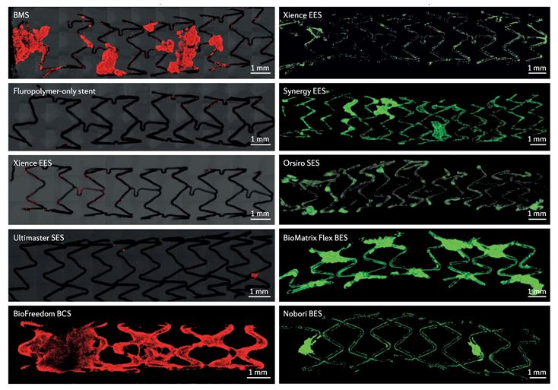
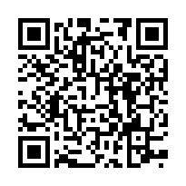
Coronary artery stents
Figure 12
Confocal microscopy images showing thrombogenicity of stents. hunt study 1 shows the thrombogenicity of a bare-metal stent (BMS), a fluoropolymer-only stent, a Xience everolimus-eluting stent (EES), an Ultimaster sirolimus- eluting stent (SES) and a BioFreedom Biolimus A9-coated stent (BCS). The low-power confocal microscopy images show very small thrombus-occupied areas in stents with fluoropolymers (that is, the fluoropolymer-only stent and the Xience EES) compared with the other stents (that is, the BMS, Ultimaster SES and BioFreedom BCS), using antibodies against dual platelet markers CD61–CD42b (shown in red). Shunt study 2 shows immunofluorescent staining against dual platelet markers (CD61–CD42b, shown in green) in a pig shunt model with the use of Xience EES, Synergy EES, Orsiro SES, BioMatrix Flex Biolimus A9-eluting stent (BES) and Nobori BES.Reproduced with permission of the publisher [63184]
Miklos Rohla, Scot Garg, Raffaele Piccolo, Sharmaine Thirunavukarasu, Patrick W. Serruys, Stephan Windecker
©2025 Europa Group - All rights reserved.

