Slide 1


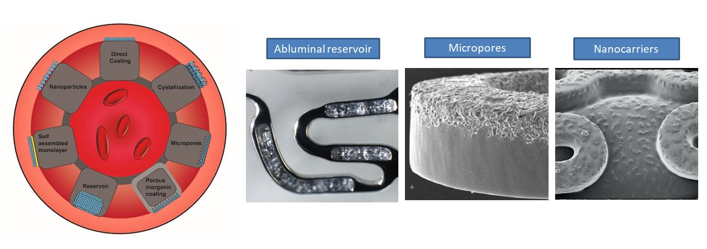

Coronary artery stents
Figure 13
Techniques for polymer-free stent coatings. Reproduced with permission from the publisher.
Miklos Rohla, Scot Garg, Raffaele Piccolo, Sharmaine Thirunavukarasu, Patrick W. Serruys, Stephan Windecker
©2025 Europa Group - All rights reserved.

