Slide 1


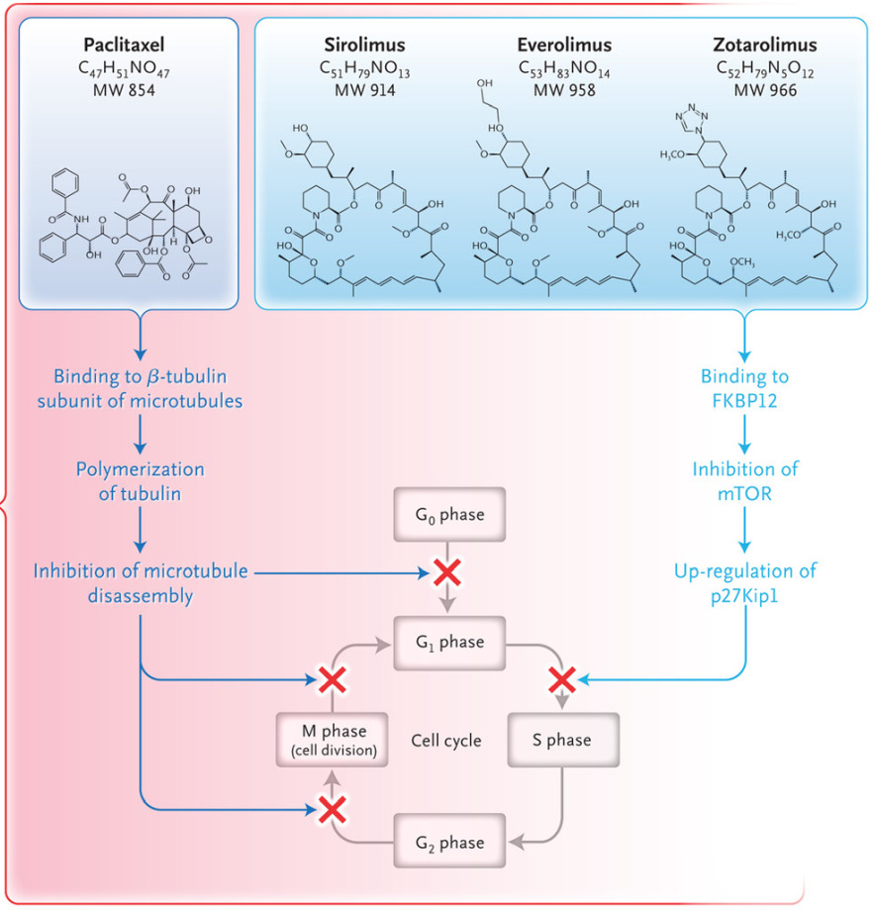

Coronary artery stents
Figure 14
The chemical structure of the macrocyclic lactone group of antiproliferative drugs of the limus family as compared to the chemical structure of paclitaxel, and their mechanism of action. Reproduced with permission of the publisher (https://doi.org/10.1056/nejmra1210816)
Miklos Rohla, Scot Garg, Raffaele Piccolo, Sharmaine Thirunavukarasu, Patrick W. Serruys, Stephan Windecker
©2025 Europa Group - All rights reserved.

