Slide 1

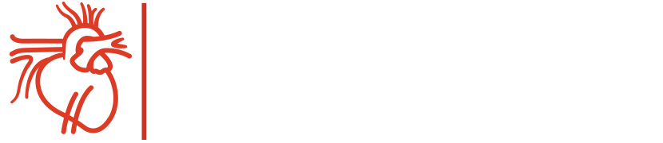
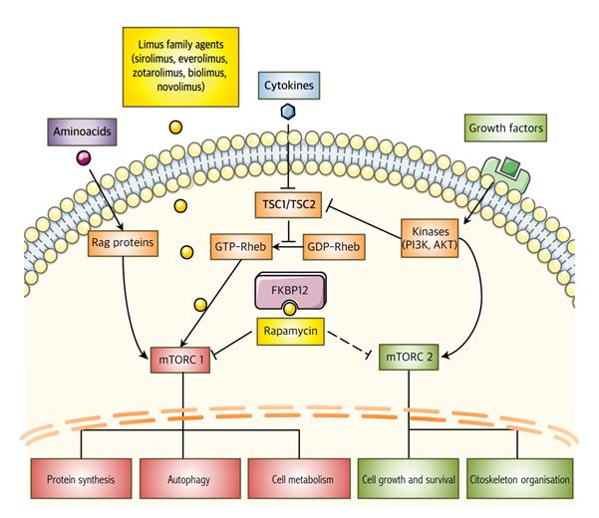

Coronary artery stents
Figure 15
Cellular effects of antiproliferative drugs of the limus family. Reproduced with permission of the publisher [63172]
Miklos Rohla, Scot Garg, Raffaele Piccolo, Sharmaine Thirunavukarasu, Patrick W. Serruys, Stephan Windecker
©2025 Europa Group - All rights reserved.

