Slide 1


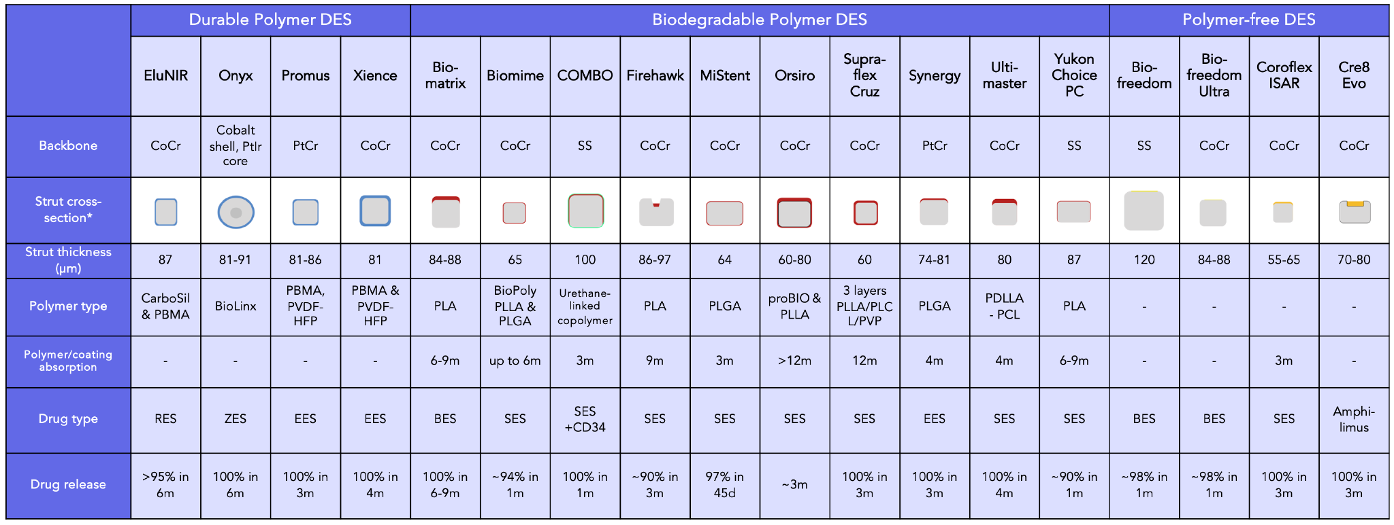

Coronary artery stents
Figure 16
Characteristics of most commonly studied and used new generation drug-eluting stent platforms with CE-mark and/or FDA approval. Metallic backbone in gray, polymer coloured: blue = durable, red = biodegradable, yellow = polymer-free, green = antibody coating. Adapted from [63139] with permission or hand-drawn by the first author. *Strut cross-sections might vary depending on stent diameter, work-horse diameters presented. AES: amphilimus-eluting stent; BES: biolimus-eluting stent;EES: everolimus-eluting stent; PBMA: poly-n-butyl methacrylate, PCL: poly(ε-caprolactone), PDLLA: poly(D,L)-lactic acid, PLA: polylactic acid, PLLA: Poly-l-Lactic acid, PLCL: Poly(L-lactide-co-ε-caprolactone), PLGA: poly-DL-lactide-co-glycolide, PVDF-HFP: poly (vinylidene fluoride-co-hexafluoropropylene), PVP: polyvinyl pyrrolidone; RES: ridaforolimus-eluting stent; SES: sirolimus-eluting stent; ZES: zotarolimus-eluting stent
Miklos Rohla, Scot Garg, Raffaele Piccolo, Sharmaine Thirunavukarasu, Patrick W. Serruys, Stephan Windecker
©2025 Europa Group - All rights reserved.

