Slide 1


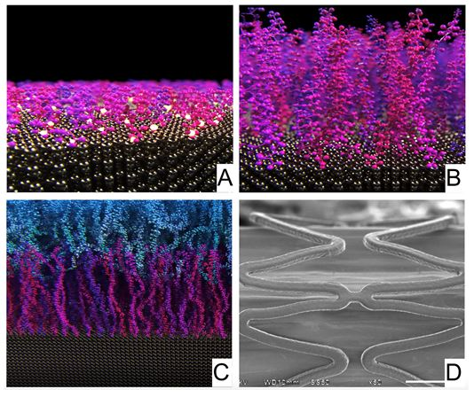

Coronary artery stents
Figure 18
Electro-grafted coating on the BuMA and HT Supreme stents: The eG CoatingTM is electro-grafted (eG) onto the surface of the stent using a proprietary electo-chemical process. (A) The stent is submerged in a PBMA monomer solution. Electric current is applied, and the polymer is electro-grafted to the stent. (B) Electric current is cycled and a brush-like structure of eG Coating is synthesized onto the surface of the stent. (C) The filament-like structure of the eG Coating allows for interdigitation of the PLGA polymer matrix containing sirolimus drug. (D) The resulting biodegradable polymer-drug coating is robust and resistant to cracking, even in areas of elastic deformation. Reproduced with permission of the publisher [63517]
Miklos Rohla, Scot Garg, Raffaele Piccolo, Sharmaine Thirunavukarasu, Patrick W. Serruys, Stephan Windecker
©2025 Europa Group - All rights reserved.

