Slide 1


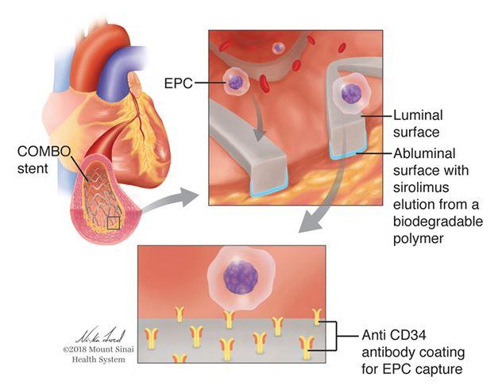

Coronary artery stents
Figure 19
The COMBO Dual Therapy Stent. Schematic representation of the endothelial progenitor cell (EPC) capture technology. A luminal pro-healing anti-CD34+ antibody layer attracts circulating endothelial progenitor cells. These endothelial progenitor cells can mature into normal endothelium, promoting endothelialization. Reproduced with permission of the publisher (https://doi.org/10.1016/j.jcin.2018.04.038)
Miklos Rohla, Scot Garg, Raffaele Piccolo, Sharmaine Thirunavukarasu, Patrick W. Serruys, Stephan Windecker
©2025 Europa Group - All rights reserved.

