Slide 1


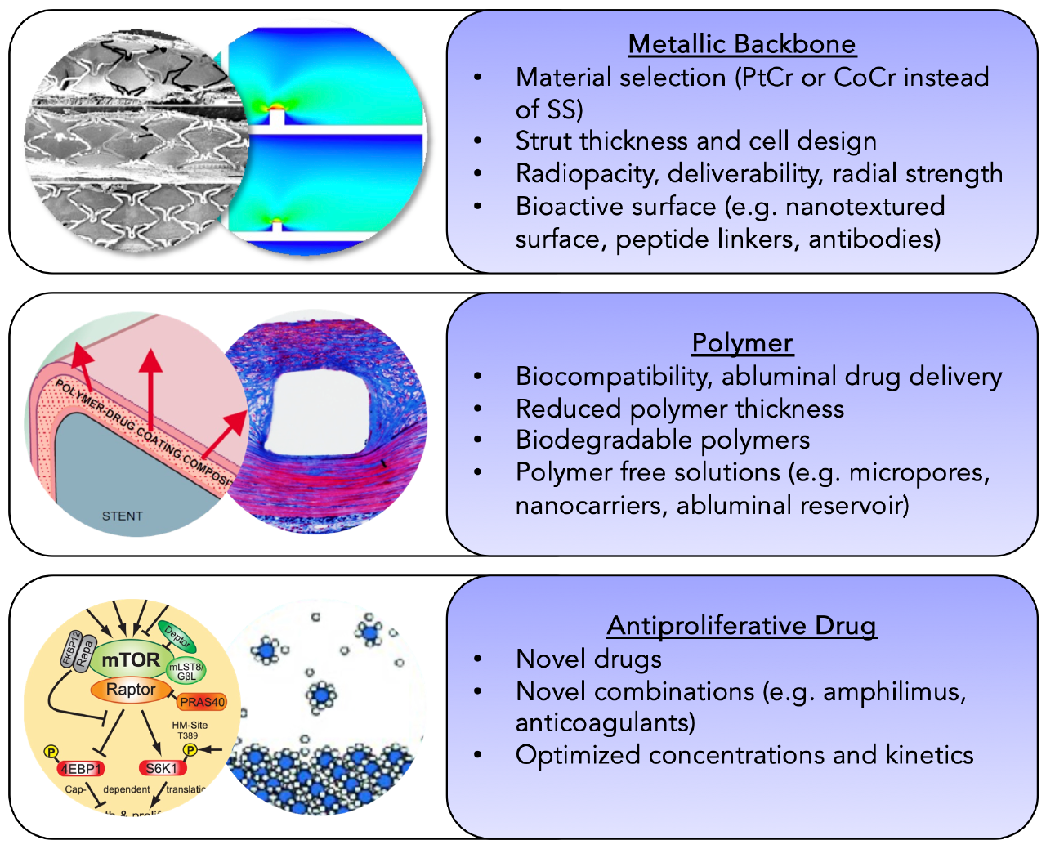

Coronary artery stents
Figure 2
Main components of newer-generation drug-eluting sents, and their options for modification.
Miklos Rohla, Scot Garg, Raffaele Piccolo, Sharmaine Thirunavukarasu, Patrick W. Serruys, Stephan Windecker
©2025 Europa Group - All rights reserved.

