Slide 1


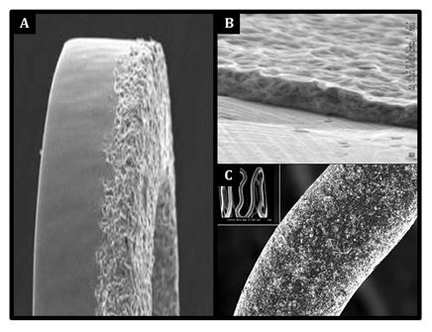

Coronary artery stents
Figure 20
Scanning electron microscopy of the surface of three different polymer-free stents. The BioFreedom™ stent (A) is a polymer-free biolimus-eluting stent made of stainless steel and a micro-structured, polymer-free surface alteration at the abluminal stent side. The VESTAsync™ stent (B) has a nano-thin, microporous, hydroxyapatite surface coating impregnated with sirolimus. The Yukon stent (C) has a microporous surface, with pores which are 2 μm deep and impregnated with sirolimus.
Miklos Rohla, Scot Garg, Raffaele Piccolo, Sharmaine Thirunavukarasu, Patrick W. Serruys, Stephan Windecker
©2025 Europa Group - All rights reserved.

