Slide 1


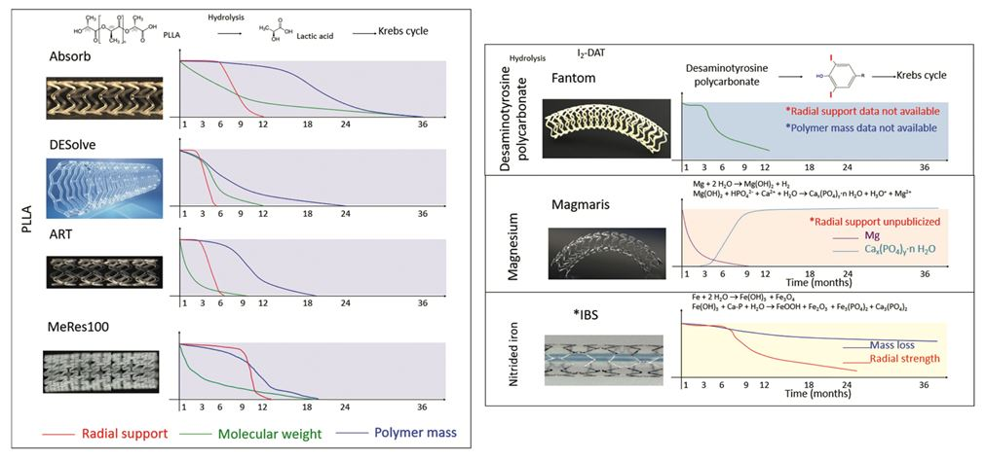

Coronary artery stents
Figure 3
A summary of the biodegradation process of polymer-based and metallic-based bioresorbable scaffolds. Reproduced with permission from the publisher under the Creative Commons Attribution-NonCommercial-NoDerivatives License(https://doi.org/10.1080/17434440.2021.1904894)
Miklos Rohla, Scot Garg, Raffaele Piccolo, Sharmaine Thirunavukarasu, Patrick W. Serruys, Stephan Windecker
©2025 Europa Group - All rights reserved.

