Slide 1


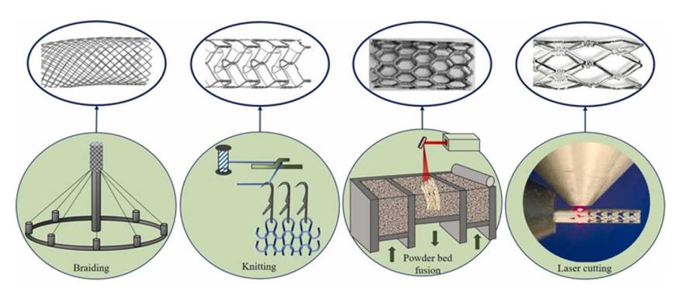

Coronary artery stents
Figure 4
Prior and contemporary manufacturing techniques of metallic stents: Obsolete coil design devices were braided or knitted from a continuously wound wires. Newer-generation drug-eluting stents are laser-cut from metallic tubes into the desired mesh-shape. Powder metallurgy is based on compaction of powdered materials, a possible method for fabricating porous iron-based biodegradable stents. Reproduced with permission from the publisher [63154]
Miklos Rohla, Scot Garg, Raffaele Piccolo, Sharmaine Thirunavukarasu, Patrick W. Serruys, Stephan Windecker
©2025 Europa Group - All rights reserved.

