Slide 1


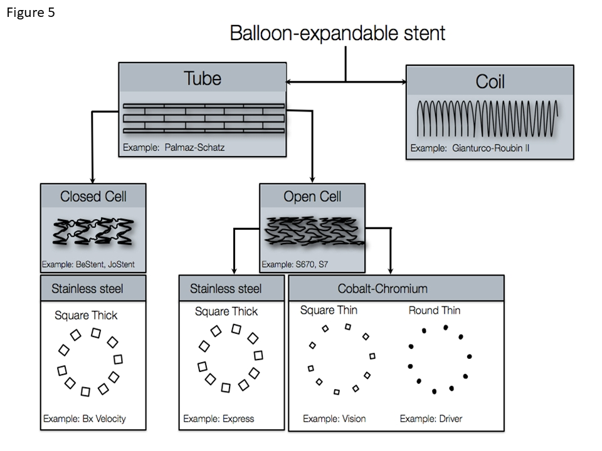

Coronary artery stents
Figure 5
Design characteristics of balloon-expandable coronary stents.
Miklos Rohla, Scot Garg, Raffaele Piccolo, Sharmaine Thirunavukarasu, Patrick W. Serruys, Stephan Windecker
©2025 Europa Group - All rights reserved.

