Slide 1


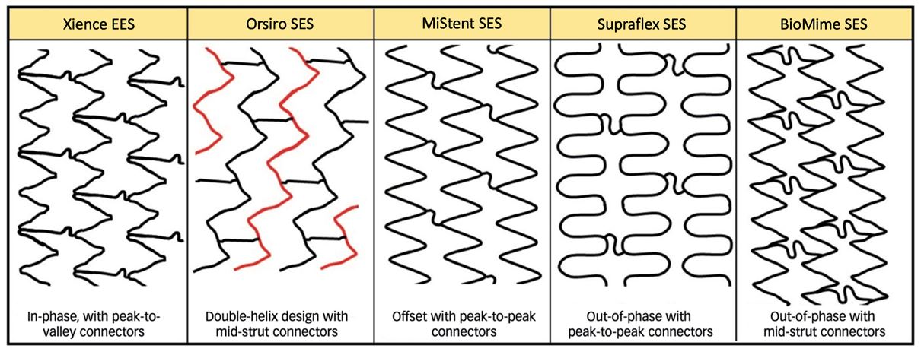

Coronary artery stents
Figure 7
Open-cell strut designs of four contemporary ultrathin-strut drug-eluting stents and their comparator in clinical trials, the Xience stent. Reproduced with permission from the publisher [63157]
Miklos Rohla, Scot Garg, Raffaele Piccolo, Sharmaine Thirunavukarasu, Patrick W. Serruys, Stephan Windecker
©2025 Europa Group - All rights reserved.

