Slide 1


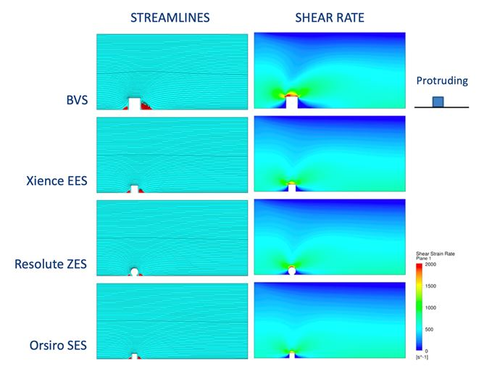

Coronary artery stents
Figure 8
The impact of stent designs with different strut crossections and heights on flow patterns and shear rates. Reproduced with permission from the publisher [63148]
Miklos Rohla, Scot Garg, Raffaele Piccolo, Sharmaine Thirunavukarasu, Patrick W. Serruys, Stephan Windecker
©2025 Europa Group - All rights reserved.

