Slide 1


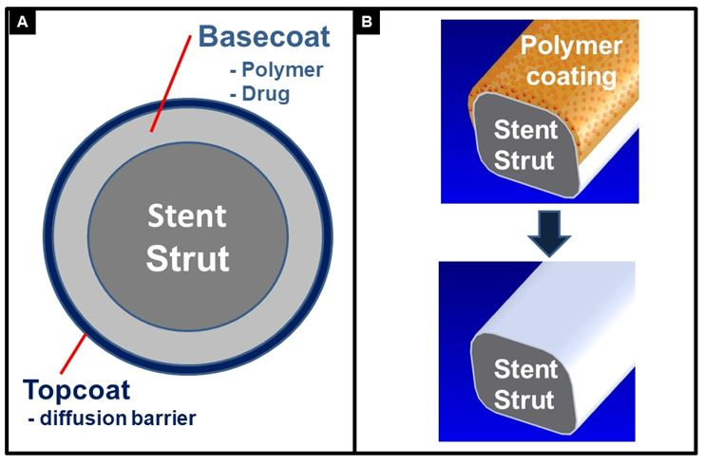

Coronary artery stents
Figure 9
Schematic drawing of the components of a drug-eluting stent with durable polymer (A) and a drug-eluting stent with bioresorbable polymer limited to the abluminal side (B).
Miklos Rohla, Scot Garg, Raffaele Piccolo, Sharmaine Thirunavukarasu, Patrick W. Serruys, Stephan Windecker
©2025 Europa Group - All rights reserved.

