Slide 1


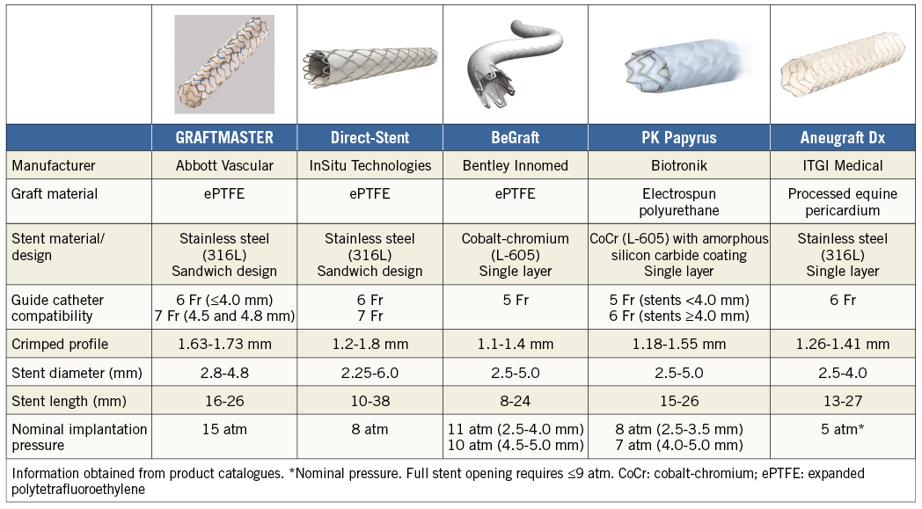

Coronary artery stents
Table 5
Covered stents.
Reproduced with the permission of the publisher.
Miklos Rohla, Scot Garg, Raffaele Piccolo, Sharmaine Thirunavukarasu, Patrick W. Serruys, Stephan Windecker
©2025 Europa Group - All rights reserved.

