Slide 1


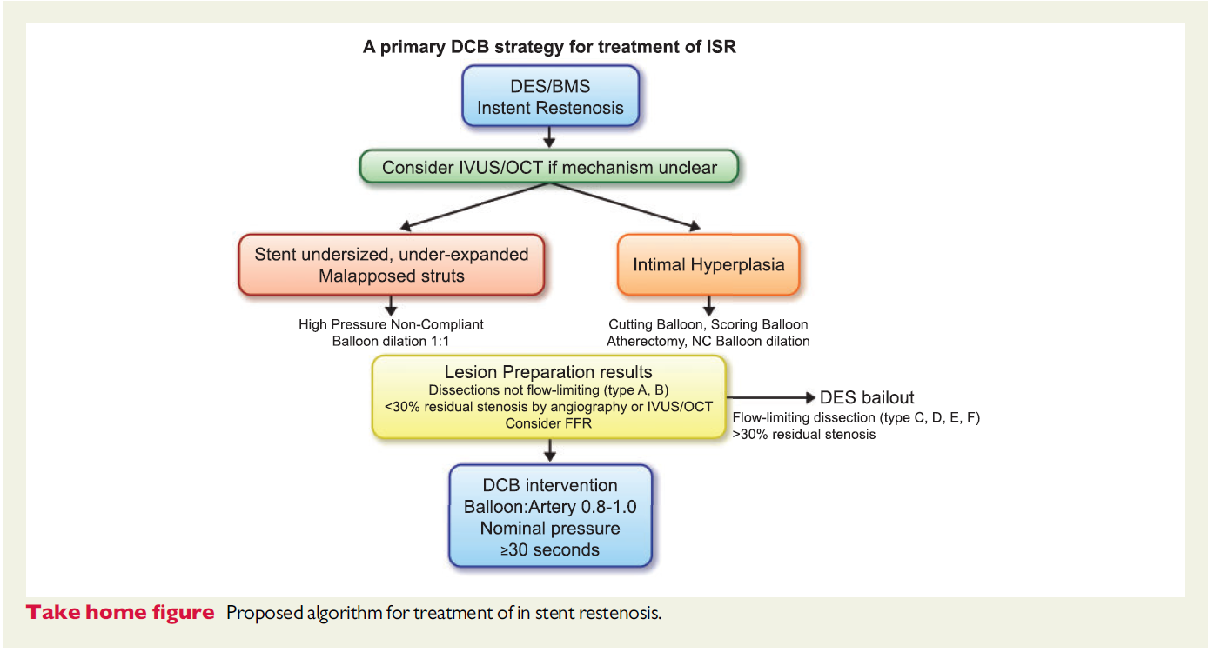

Drug-coated balloons (old)
Figure 3
From Lansky et al., Eur Heart J. 2020 Oct 7;41(38):3729-3731
Bruno Scheller
©2025 Europa Group - All rights reserved.

