Slide 1


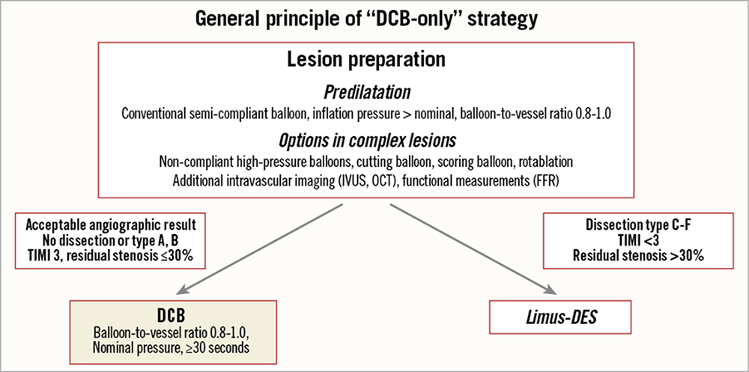
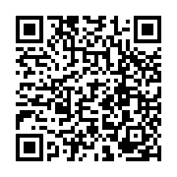
Drug-coated balloons (old)
Figure 4
Consensus group algorithm for the use of drug coated balloon in practice
Bruno Scheller
©2025 Europa Group - All rights reserved.

