Slide 1


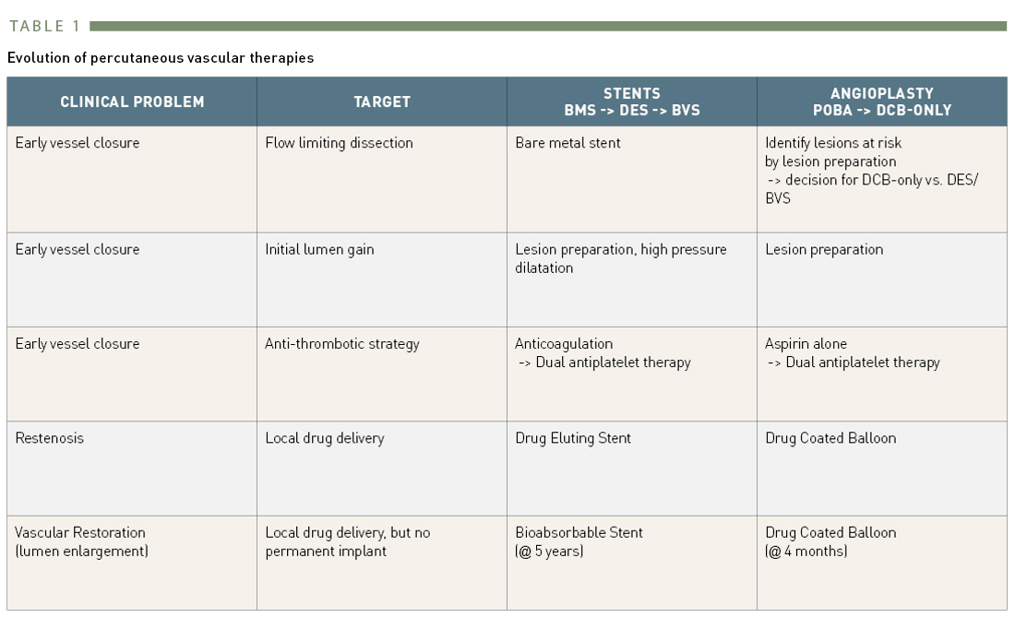
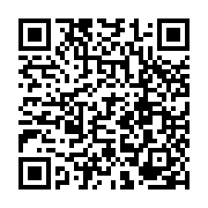
Drug-coated balloons (old)
Table 1
Evolution of percutaneous vascular therapies
Bruno Scheller
©2025 Europa Group - All rights reserved.

