Slide 1


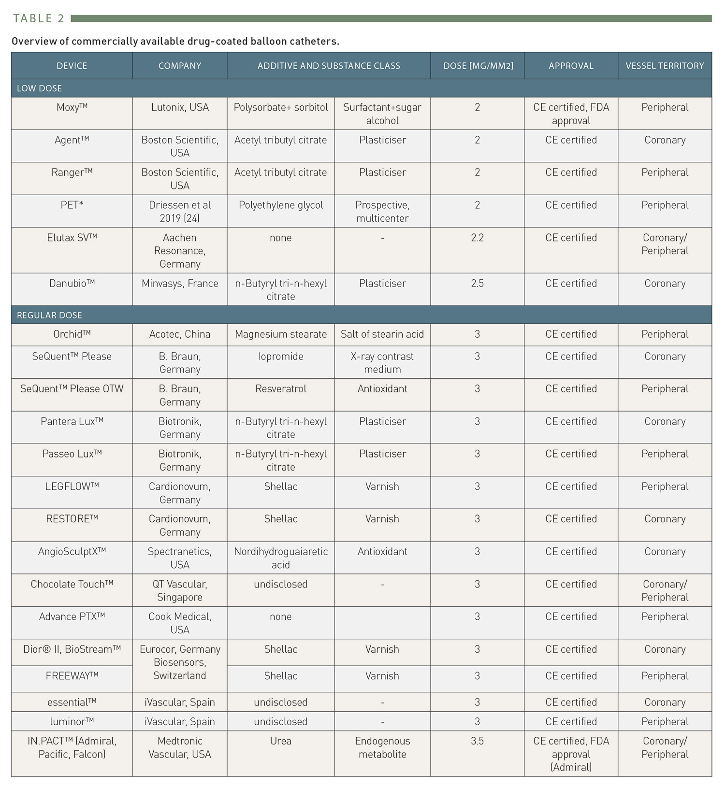

Drug-coated balloons (old)
Table 2
Overview of commercially available drug-coated balloon catheters.
Bruno Scheller
©2025 Europa Group - All rights reserved.

