Slide 1


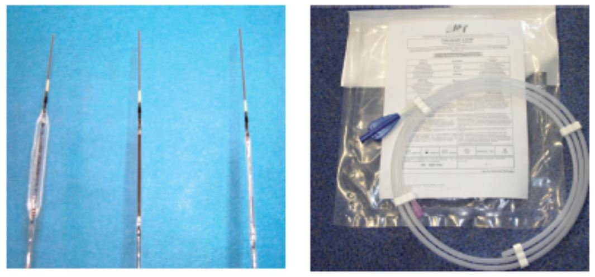

Drug-coated balloons
Figure 1
Early prototypes of coated balloon catheters, ca. 2001. Right: Paccocath balloon catheter before sterilisation. Clinical trial sample for the Paccocath ISR trial, 2003. Adapted from [67319]. ​
Bruno Scheller, Saarraaken Kulenthiran, Davor Vukadinović
©2025 Europa Group - All rights reserved.

