Slide 1


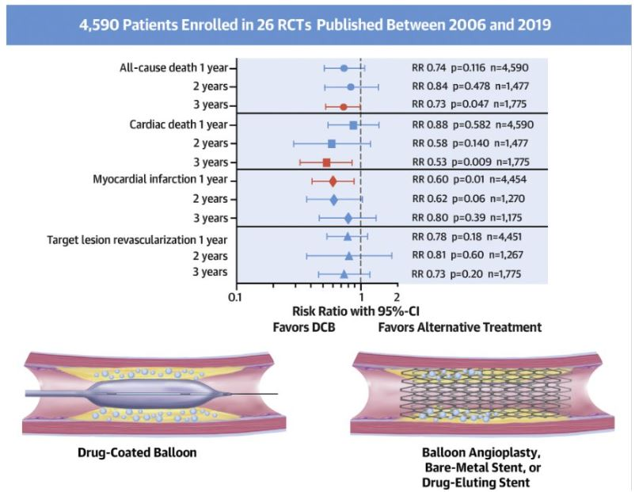

Drug-coated balloons
Figure 10
Safety of coronary paclitaxel DCB. Meta-analysis investigating the available data on survival after coronary intervention with paclitaxel-coated balloons from randomised, controlled trials. A total of 4,590 patients enrolled in 26 RCT published between 2006 and 2019 were analysed. Summary of the treatment effects for paclitaxel-coated balloon vs. alternative treatments. Relative risk of all-cause death, cardiac death, myocardial infarction, and target lesion revascularisation at one, two, and three years post-treatment. Adapted from (53).
Bruno Scheller, Saarraaken Kulenthiran, Davor Vukadinović
©2025 Europa Group - All rights reserved.

