Slide 1


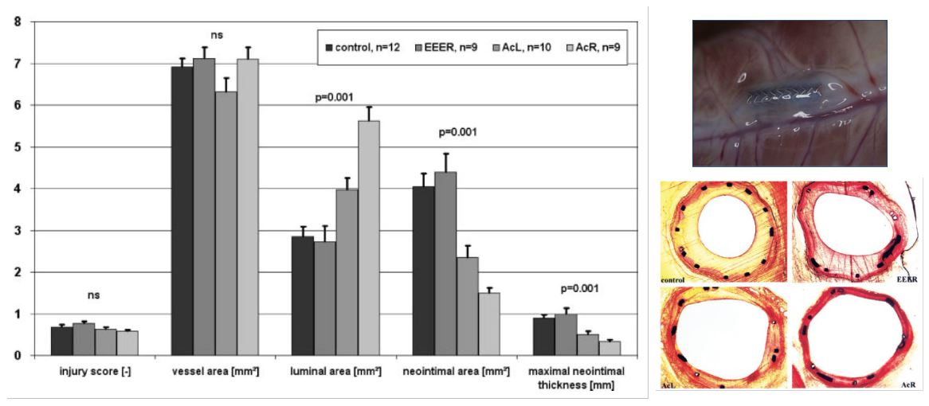

Drug-coated balloons
Figure 2
Histology and histomorphometry of stented porcine coronary arteries after 35 days. Implantation of bare metal stents with conventional PTCA catheters (control) and paclitaxel-coated, PTCA catheters with EEER coating or Ac coating (AcL and AcR). Parameters shown are injury score, vessel area, luminal area, neointimal area, and maximal neointimal thickness. Abbreviations are as defined in text. Values are mean±SD, n=40. EEER=ethyl acetate as the solvent with ≈2 μg paclitaxel/mm2 balloon surface, AcL=acetone as solvent with 1.3 μg paclitaxel/mm2 balloon surface (low dose paclitaxel), AcR=acetone as solvent with 2.5 μg paclitaxel/mm2 balloon surface (regular dose). Adapted from [67199].
Bruno Scheller, Saarraaken Kulenthiran, Davor Vukadinović
©2025 Europa Group - All rights reserved.

