Slide 1


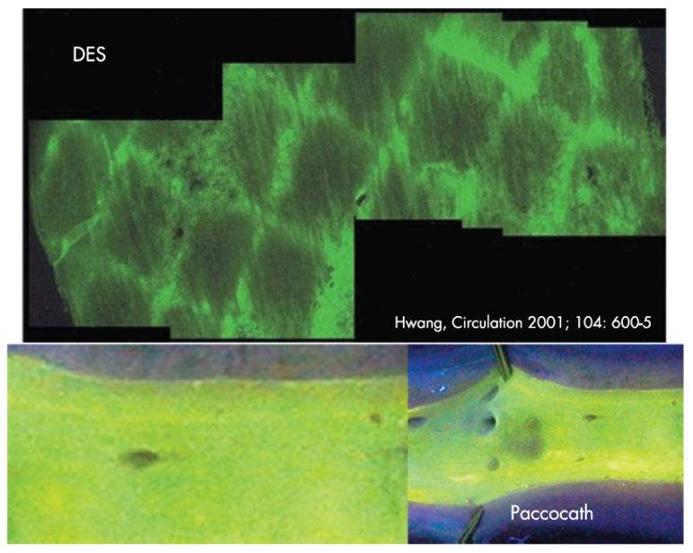

Drug-coated balloons
Figure 3
Inhomogeneous drug distribution from the luminal surface after stent implantation versus homogenous drug distribution from drug-coated balloon surface. Adapted from [67211,67214].
Bruno Scheller, Saarraaken Kulenthiran, Davor Vukadinović
©2025 Europa Group - All rights reserved.

