Slide 1


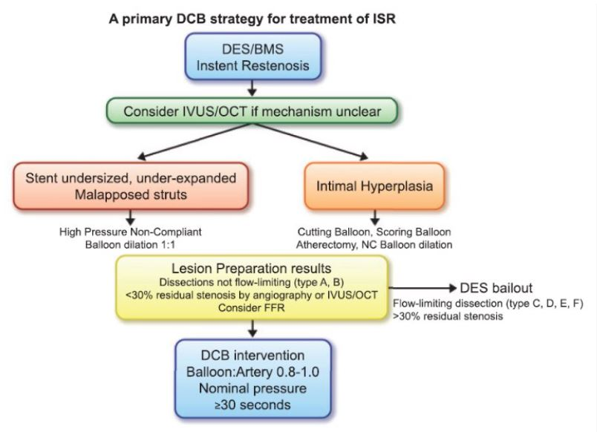
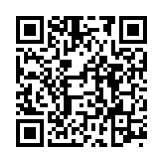
Drug-coated balloons
Figure 5
Proposed algorithm for the treatment of in-stent restenosis with a primary drug-coated balloon strategy. Adapted from (48).
Bruno Scheller, Saarraaken Kulenthiran, Davor Vukadinović
©2025 Europa Group - All rights reserved.

