Slide 1


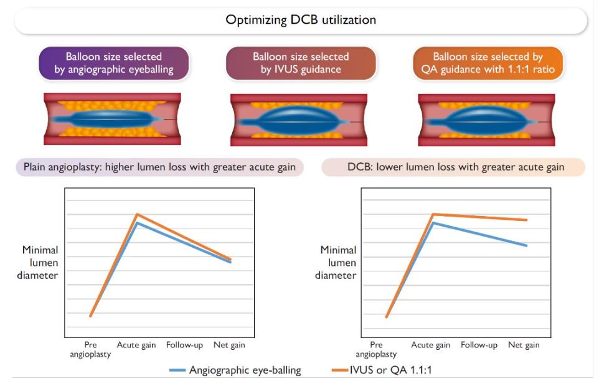

Drug-coated balloons
Figure 6
The more you gain the more you get. Benefits of an aggressive primary treatment of femoropopliteal artery disease guided by intravascular ultrasound (IVUS) or quantitative angiography (QA) with balloon oversizing of 1.1:1. Proposed mechanisms of an improved initial lumen gain resulting in reduced net gain at follow-up after uncoated angioplasty (left) or the additional effect of higher dissection grade on late lumen loss after paclitaxel-coated balloon (DCB) treatment (right). Adapted from (73).
Bruno Scheller, Saarraaken Kulenthiran, Davor Vukadinović
©2025 Europa Group - All rights reserved.

