Slide 1


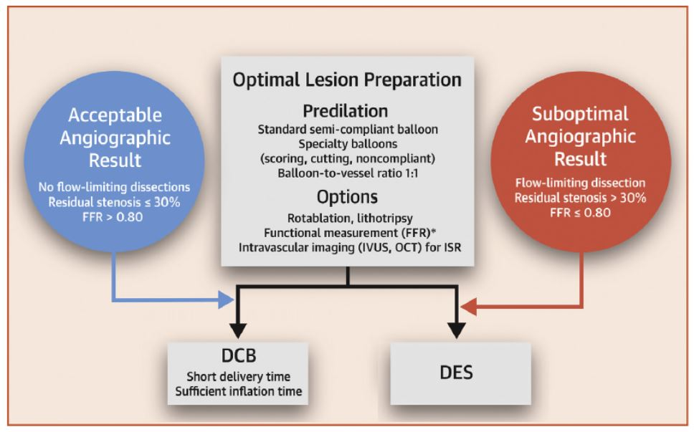
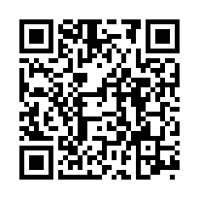
Drug-coated balloons
Figure 7
General algorithm for treatment of de novo lesions according to the international DCB consensus group. Focus on lesion preparation, decision between DCB or DES depending on the result of lesion preparation. Adapted from [67478].
Bruno Scheller, Saarraaken Kulenthiran, Davor Vukadinović
©2025 Europa Group - All rights reserved.

