Slide 1


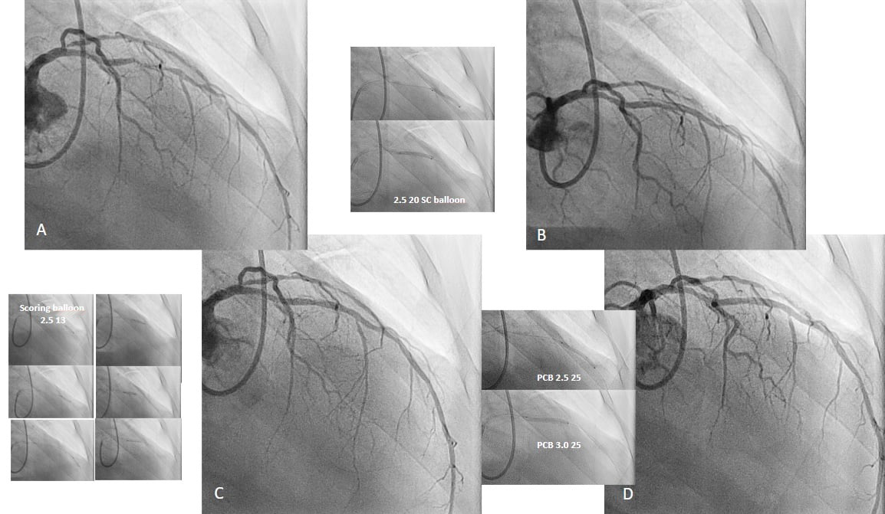

Drug-coated balloons
Figure 8
Example of stepwise lesion preparation in a 68-year-old male presenting with diabetes, hypertension, ex-smoker, angina CCS III. A) Long diffuse disease in the mid-left anterior descending artery. B) Dissection and insufficient lumen gain in the distal part after semi-compliant balloon inflation. C) Reduced dissection grade and improved lumen gain in the whole segment after multiple scoring balloon inflations. D) Final result after 2 paclitaxel DCB.
Bruno Scheller, Saarraaken Kulenthiran, Davor Vukadinović
©2025 Europa Group - All rights reserved.

