Slide 1


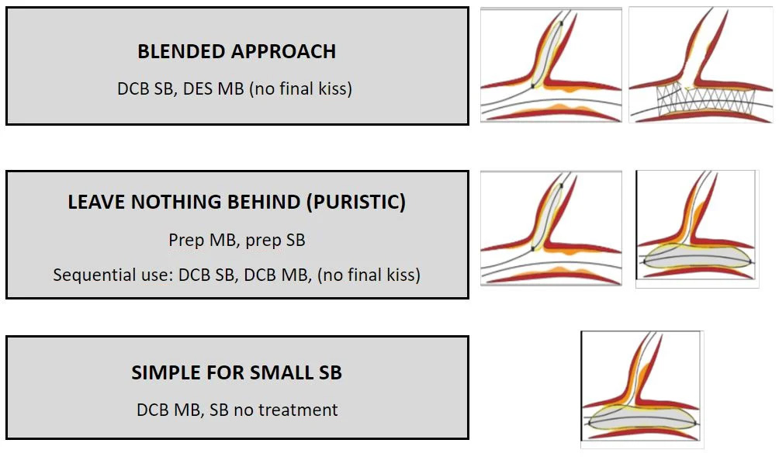
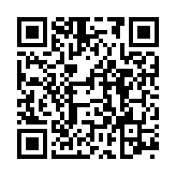
Drug-coated balloons
Figure 9
Different scenarios of DCB treatment in coronary bifurcations. DCB drug -oated balloon, DES drug-eluting stent, MB main branch, SB side branch.
Bruno Scheller, Saarraaken Kulenthiran, Davor Vukadinović
©2025 Europa Group - All rights reserved.

