Slide 1


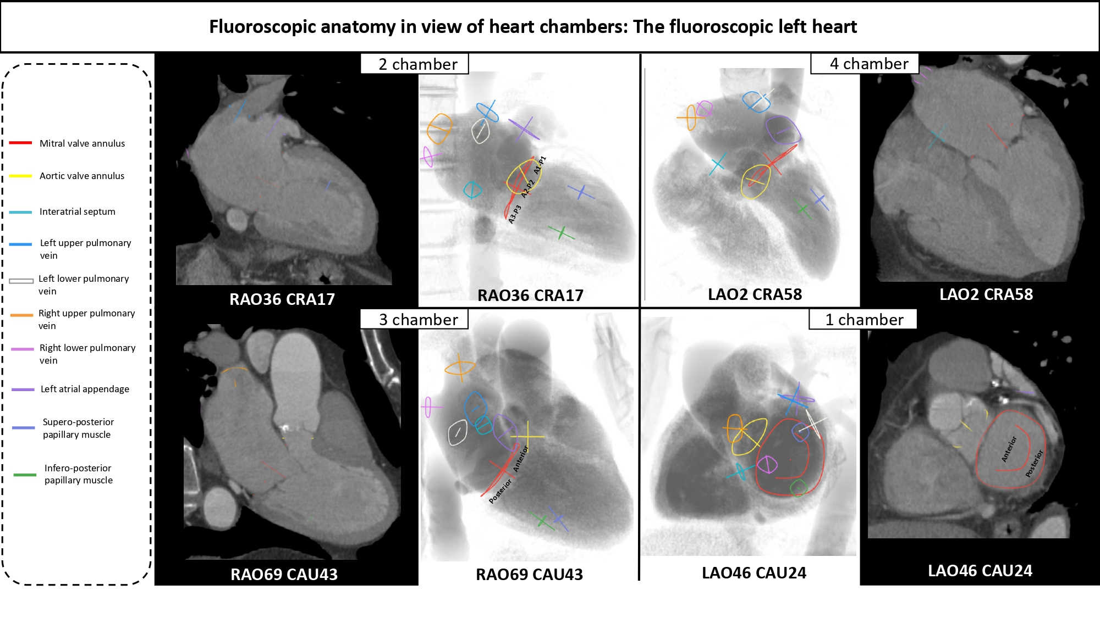

Echocardiographic, Fluoroscopic and CT guidance for transcatheter structural and coronary interventions
Figure 10
Fluoroscopic left sided cardiac structures across the multislice computer tomography and fluoroscopic 4 chamber views. The main cardiac structures are highlighted with circles according the left column color code.
Horacio Medina de Chazal, Ali Zgheib, Angelo Quagliana, Michael Chetrit, Jean Buithieu, Giuseppe Martucci, Marco Spaziano, Ali Abualsaud, Ole de Baker, Laurence Campens, Pascal Theriault-Lauzier, Jeremy Ben-Shoshan, Nicolo Piazza
©2025 Europa Group - All rights reserved.

