Slide 1


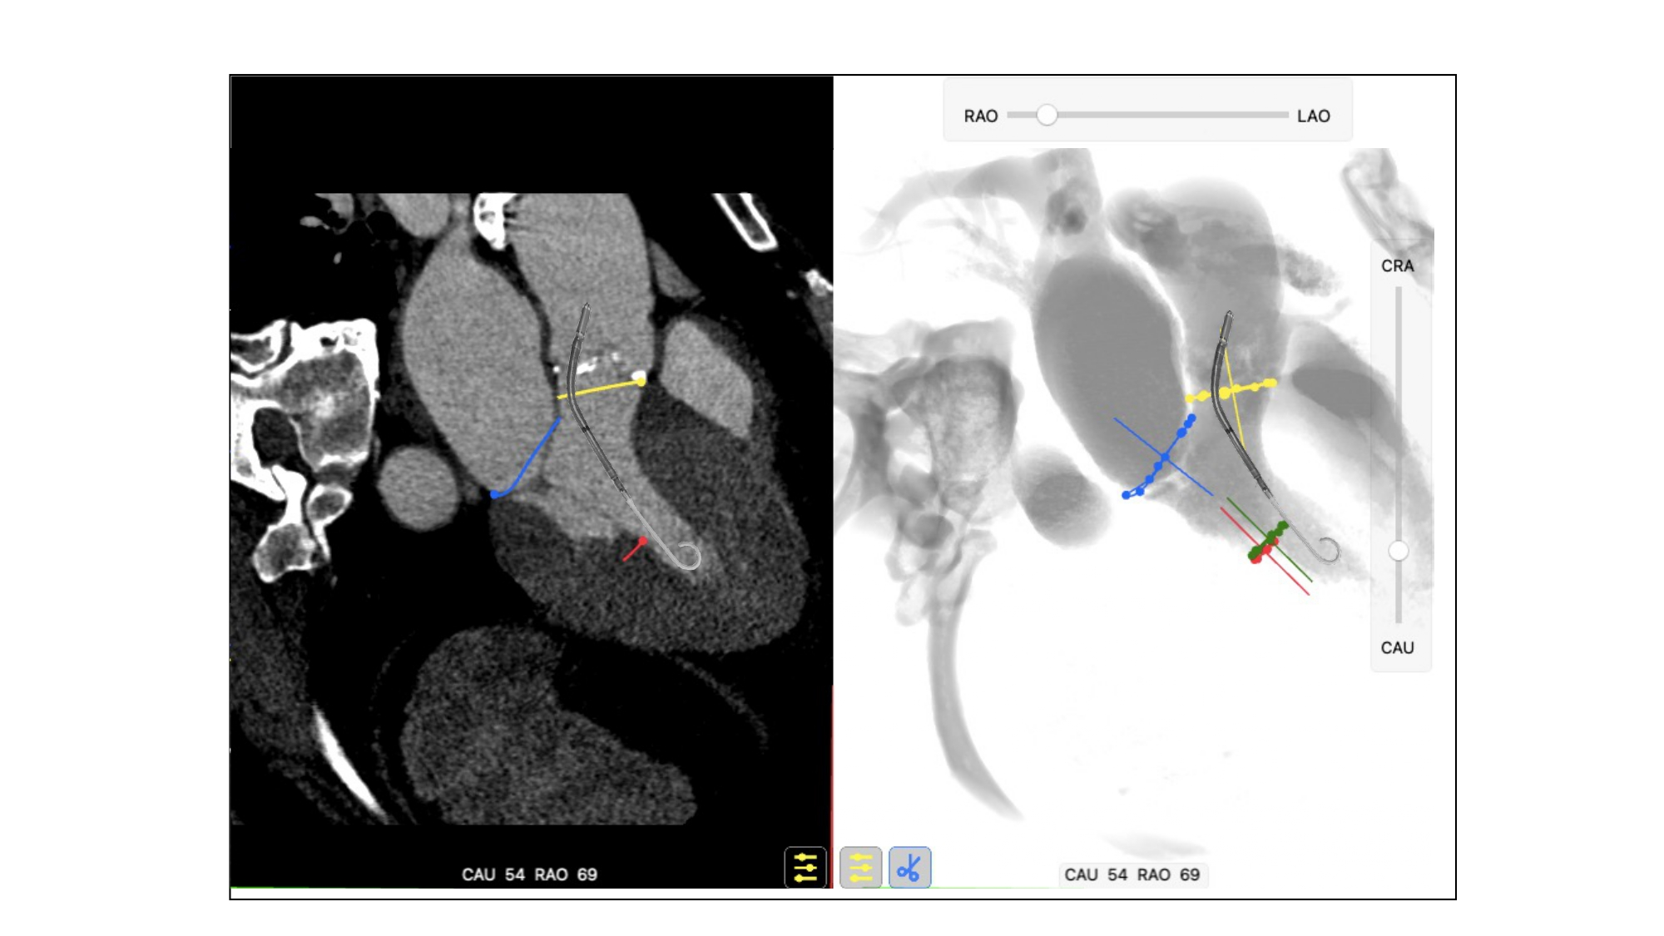

Echocardiographic, Fluoroscopic and CT guidance for
transcatheter structural and coronary interventions
Figure 11
Usefulness of fluoroscopic 3-chamber view for Impella positioning. The 3-chamber view overlaps both papillary muscles (red and green circles) on the inferior aspect of the left ventricle and can be used to avoid them during stiff guidewire or Impella positioning.
Horacio Medina de Chazal, Ali Zgheib, Angelo Quagliana, Michael Chetrit, Jean Buithieu, Giuseppe Martucci, Marco
Spaziano, Ali Abualsaud, Ole de Baker, Laurence Campens, Pascal Theriault-Lauzier, Jeremy Ben-Shoshan, Nicolo Piazza
©2025 Europa Group - All rights reserved.

