Slide 1


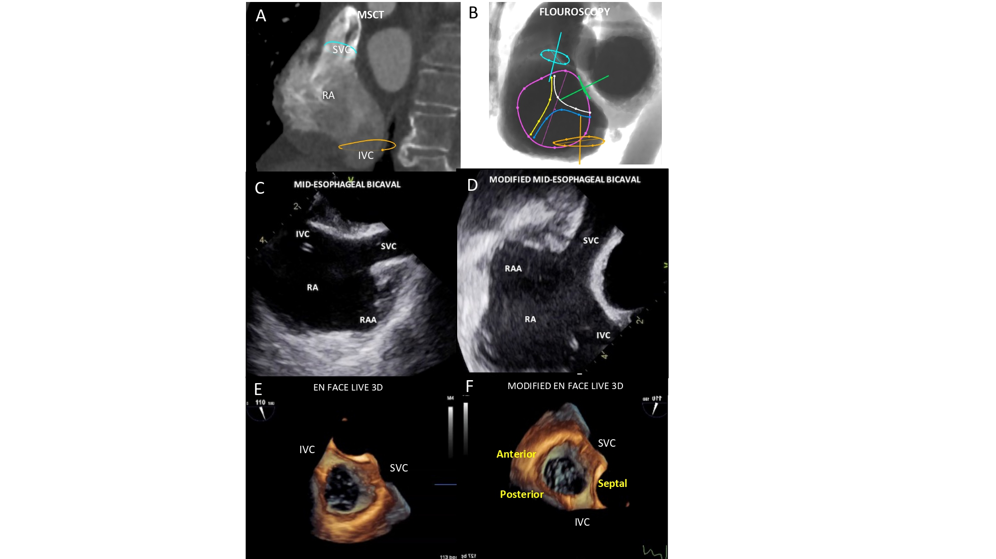

Echocardiographic, Fluoroscopic and CT guidance for transcatheter structural and coronary interventions
Figure 16
Bicaval view. MSCT (A), fluoroscopic (B), conventional and modified TEE (C-D) and TEE Live 3D (E-F) bicaval matching views of the right atrium. The modified echocardiographic displays were inverted left/right and rotated 90 clockwise from the classical TEE bicaval view. In this view the superior and inferior venae cavae (turquoise and orange circles, respectively) can be visualized both in plane as well as the inferior vena cava and the interatrial septum (green circle). The fluoroscopic is obtained by angulating the C-arm in a LAO90°/CRA10° projection. Tricuspid valve (violet circle) is “en face” and its anterior (yellow line), posterior (blue line) and septal (white line) leaflets are separated.
Horacio Medina de Chazal, Ali Zgheib, Angelo Quagliana, Michael Chetrit, Jean Buithieu, Giuseppe Martucci, Marco Spaziano, Ali Abualsaud, Ole de Baker, Laurence Campens, Pascal Theriault-Lauzier, Jeremy Ben-Shoshan, Nicolo Piazza
©2025 Europa Group - All rights reserved.

