Slide 1


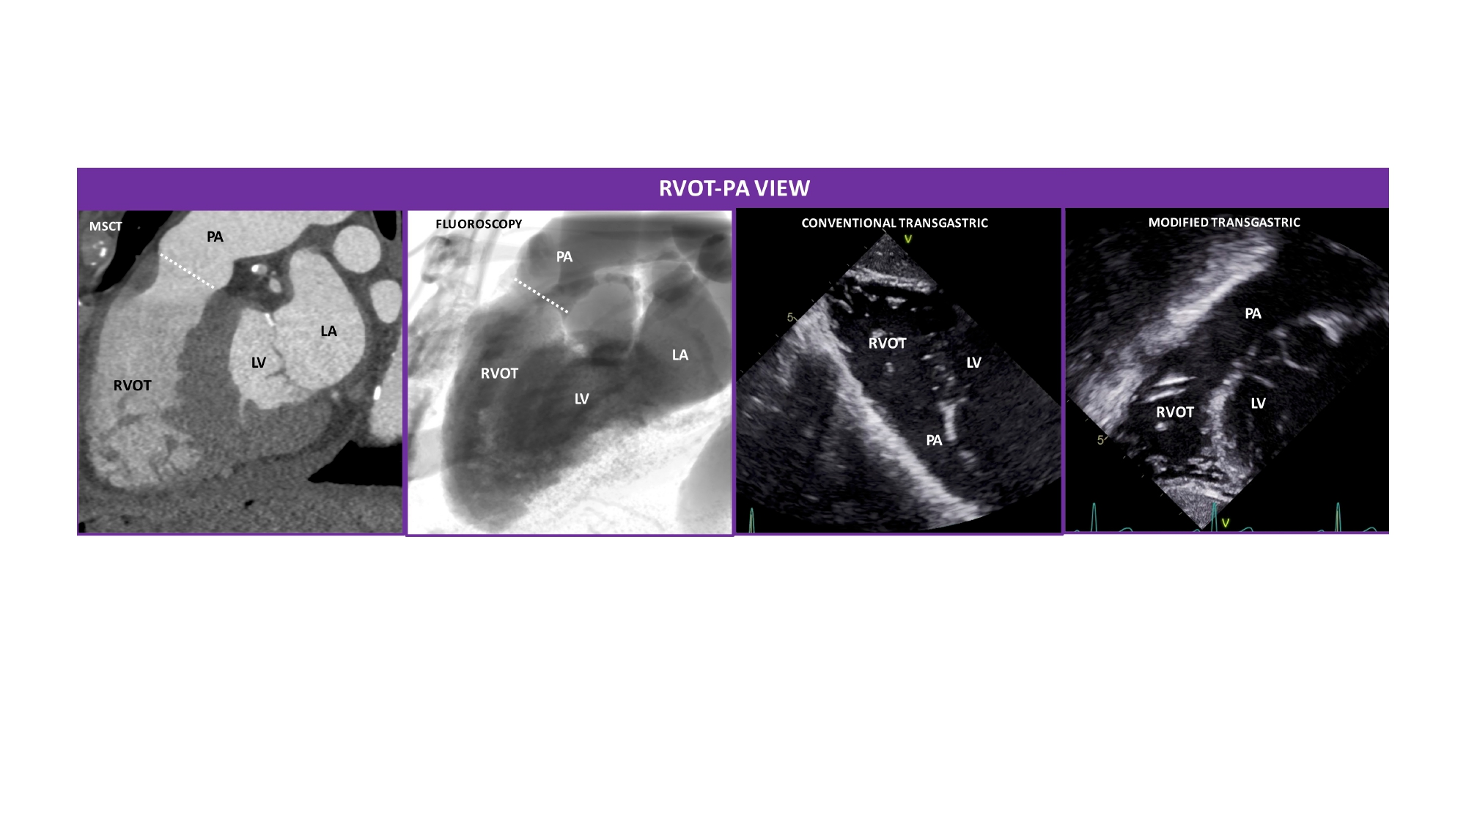

Echocardiographic, Fluoroscopic and CT guidance for
transcatheter structural and coronary interventions
Figure 18
Right ventricle outflow tract (RVOT)-pulmonary artery view. MSCT, fluoroscopic, conventional and modified transthoracic echocardiographic views of the RVOT and PA. The RVOT and the PA appear elongated and separated by the annulus of the pulmonary valve (PV) (white dotted line). The fluoroscopic is obtained by angulating the C-arm in a LAO90°/CRA10° projection. The conventional transgastric view was flipped upside-down to reproduce the MSCT and fluoroscopic views.
Horacio Medina de Chazal, Ali Zgheib, Angelo Quagliana, Michael Chetrit, Jean Buithieu, Giuseppe Martucci, Marco
Spaziano, Ali Abualsaud, Ole de Baker, Laurence Campens, Pascal Theriault-Lauzier, Jeremy Ben-Shoshan, Nicolo Piazza
©2025 Europa Group - All rights reserved.

