Slide 1


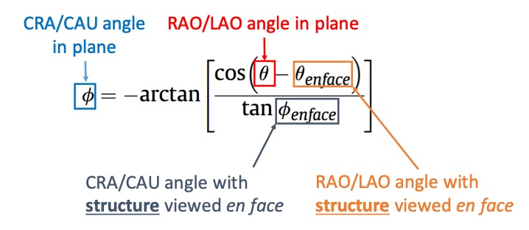

Echocardiographic, Fluoroscopic and CT guidance for
transcatheter structural and coronary interventions
Figure 19
Equation defining an optimal projection curve. Given an en-face viewing angle of a structure, it is possible to derive an optimal projection curve representing all the combinations of view angles in which the structure is seen in plane (perpendicular to its axis of symmetry) by the shown equation where: ∅ is the cranio-caudal angle of the optimal projection curve at RAO/LAO angle θ and; ∅ en-face and θ en-face are respectively the CRA/CAU and RAO/LAO angles of the structure viewed en-face. Alternatively, optimal projection curves can be generated from two random perpendicular views of the structure, instead of one en-face view.
Horacio Medina de Chazal, Ali Zgheib, Angelo Quagliana, Michael Chetrit, Jean Buithieu, Giuseppe Martucci, Marco
Spaziano, Ali Abualsaud, Ole de Baker, Laurence Campens, Pascal Theriault-Lauzier, Jeremy Ben-Shoshan, Nicolo Piazza
©2025 Europa Group - All rights reserved.

