Slide 1


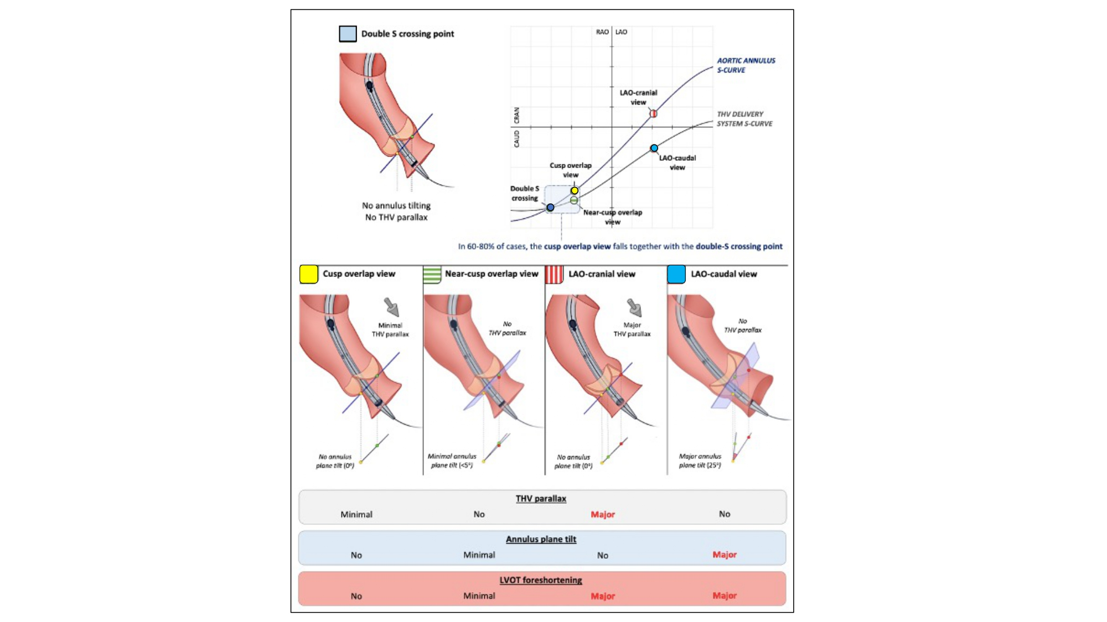

Echocardiographic, Fluoroscopic and CT guidance for
transcatheter structural and coronary interventions
Figure 26
Double S-curve and implantation of self-expanding THVs. The intersection of the aortic annulus and transcatheter heart valve (THV) delivery system S-curves (which define both structures in plane) is in most cases situated in the RAO-CAUD quadrant (“double S crossing point”). In an ideal scenario, implantation of self-expanding THVs would be performed using this fluoroscopic projection; however, the fluoroscopic projection corresponding with the double S crossing point cannot be determined preprocedurally. When deploying self-expanding THVs in a (near) R-L cusp overlap view, one approximates this double S crossing point, inducing minimal THV parallax or tilt in the annular plane. The more one works in an LAO projection, the more the S-curves of the aortic annulus and THV delivery system separate, with the result that both structures are visualized in a different plane (thereby inducing a problem for accurate assessment of THV implantation depth). RAO, right anterior oblique; CAU, caudal; LAO, left anterior oblique [12].
Horacio Medina de Chazal, Ali Zgheib, Angelo Quagliana, Michael Chetrit, Jean Buithieu, Giuseppe Martucci, Marco
Spaziano, Ali Abualsaud, Ole de Baker, Laurence Campens, Pascal Theriault-Lauzier, Jeremy Ben-Shoshan, Nicolo Piazza
©2025 Europa Group - All rights reserved.

