Slide 1


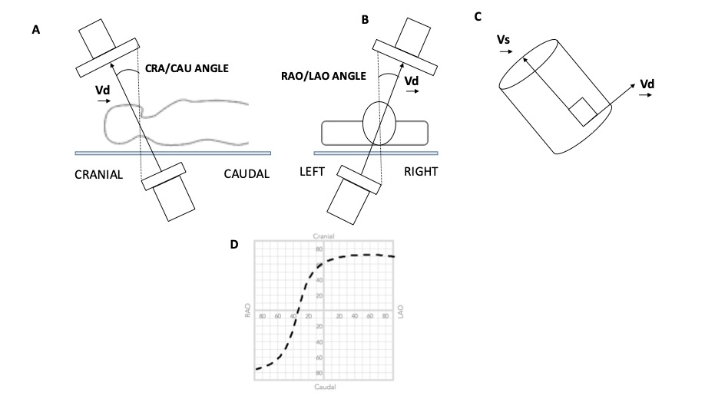

Echocardiographic, Fluoroscopic and CT guidance for
transcatheter structural and coronary interventions
Figure 3
Geometry of the Optimal Projection Curve. The vector joining the x-ray source and the center point of the detector is designated Vd, and the vector pointing along a structure of interest is Vs. (A and B) The angular system (cranial [CRA]/caudal [CAU] and right anterior oblique [RAO]/left anterior oblique [LAO] angles) used in fluoroscopy is described. (C) All vectors Vd perpendicular to vector vs are optimal viewing angles. The optimal projection curve is the plot of the fluoroscopic angles of all vectors Vd for a particular structure of interest. (D) A typical S-shaped optimal projection curve for a given cardiac structure is shown.
Horacio Medina de Chazal, Ali Zgheib, Angelo Quagliana, Michael Chetrit, Jean Buithieu, Giuseppe Martucci, Marco
Spaziano, Ali Abualsaud, Ole de Baker, Laurence Campens, Pascal Theriault-Lauzier, Jeremy Ben-Shoshan, Nicolo Piazza
©2025 Europa Group - All rights reserved.

