Slide 1


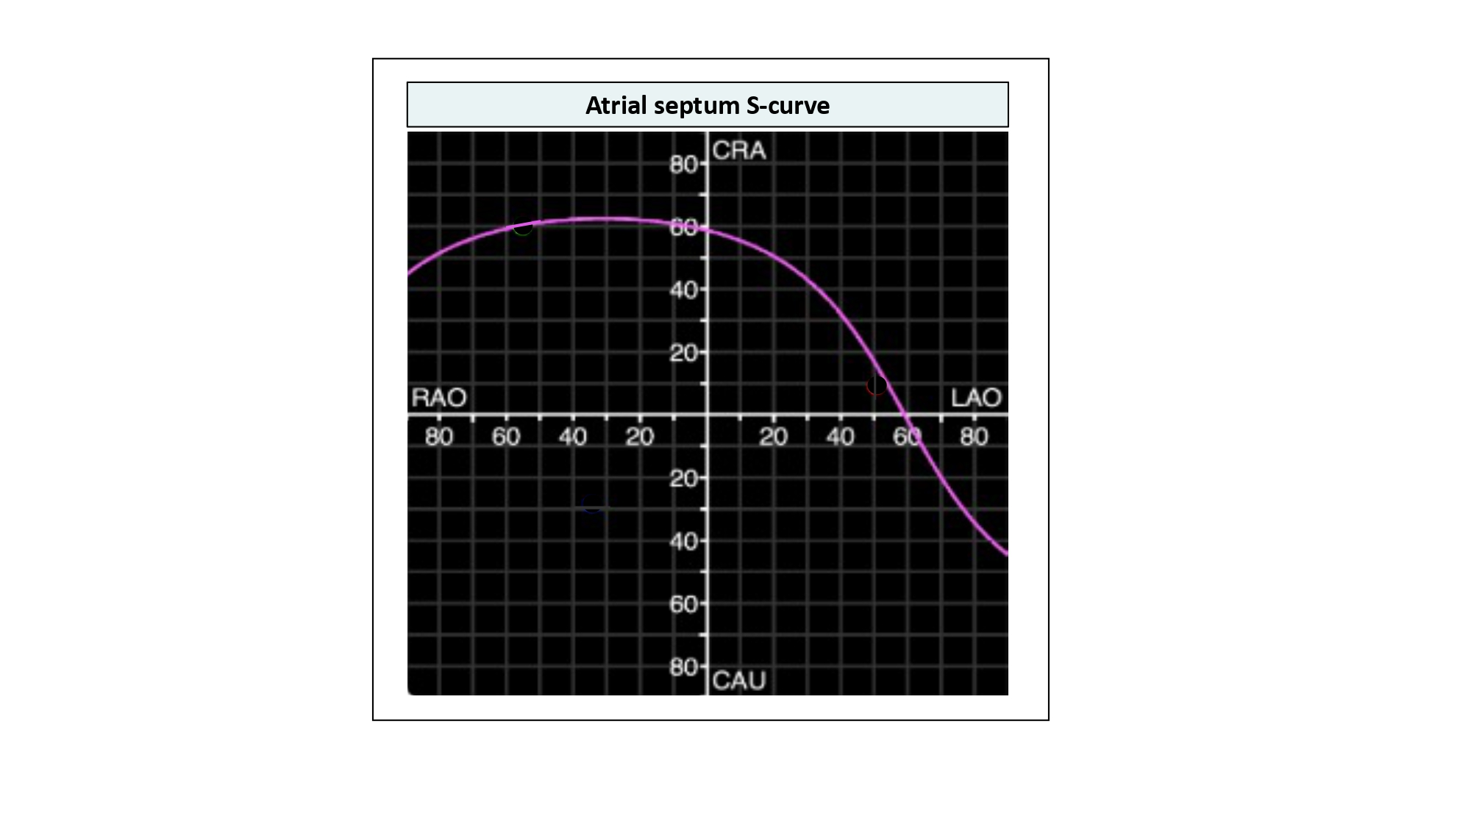

Echocardiographic, Fluoroscopic and CT guidance for
transcatheter structural and coronary interventions
Figure 31
Atrial septum S-curve. The typical atrial septum S-curve transects the RAO CRA, LAO CRA, and LAO CAU quadrants of the fluoroscopic grid; it is in these quadrants where the atrial septum is appreciated in plane.
Horacio Medina de Chazal, Ali Zgheib, Angelo Quagliana, Michael Chetrit, Jean Buithieu, Giuseppe Martucci, Marco
Spaziano, Ali Abualsaud, Ole de Baker, Laurence Campens, Pascal Theriault-Lauzier, Jeremy Ben-Shoshan, Nicolo Piazza
©2025 Europa Group - All rights reserved.

