Slide 1


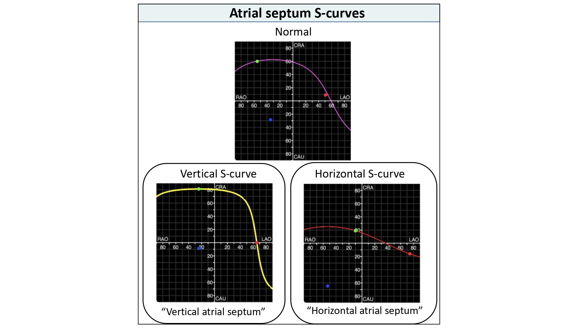

Echocardiographic, Fluoroscopic and CT guidance for
transcatheter structural and coronary interventions
Figure 33
Atrial septum S-curves. Atrial enlargement (i.e., right, left or biatrial) can change the attitudinal orientation of the atrial septum and therefore influence the shape of the atrial septum S-curve. A vertical atrial septum orientation will be represented by a vertical atrial septum s-curve. A horizontal atrial septum will translate into a horizontal atrial septum s-curve.
Horacio Medina de Chazal, Ali Zgheib, Angelo Quagliana, Michael Chetrit, Jean Buithieu, Giuseppe Martucci, Marco
Spaziano, Ali Abualsaud, Ole de Baker, Laurence Campens, Pascal Theriault-Lauzier, Jeremy Ben-Shoshan, Nicolo Piazza
©2025 Europa Group - All rights reserved.

