Slide 1


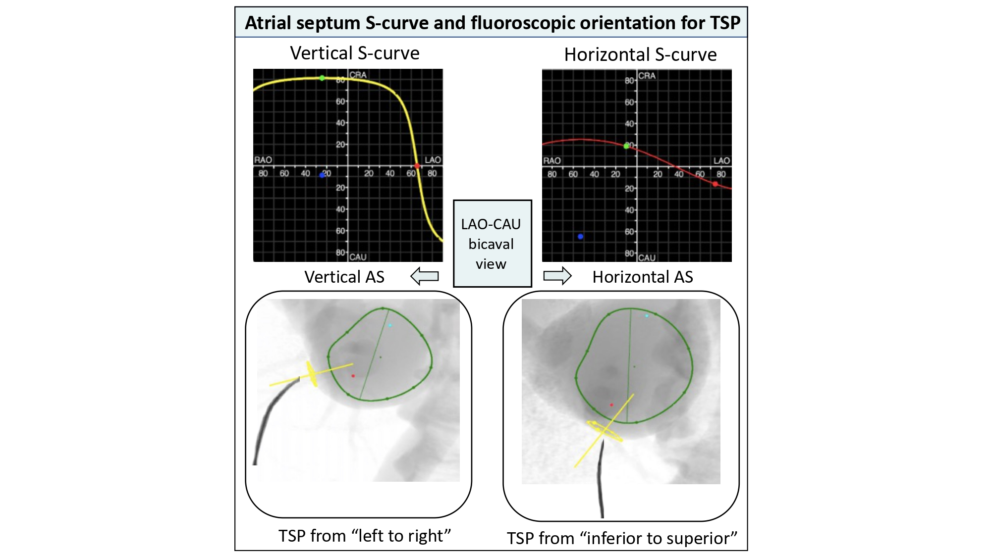
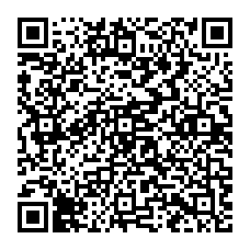
Echocardiographic, Fluoroscopic and CT guidance for transcatheter structural and coronary interventions
Figure 34
Atrial septum S-curve and fluoroscopic orientation for transeptal puncture. The orientation of the atrial septum is best appreciated in the LAO-CAU bicaval view. Vertical S-curve will translate into vertical atrial septum on the fluoroscopic screen; therefore, the needle will need a generous curve and point from left to right on the screen. Horizontal S-curve will translate into horizontal atrial septum, the needle will require less curvature as it points from inferior to superior on the fluoroscopic screen. TSP: transseptal puncture. AS: atrial septum. LAO-CAU: left anterior oblique-caudal.
Horacio Medina de Chazal, Ali Zgheib, Angelo Quagliana, Michael Chetrit, Jean Buithieu, Giuseppe Martucci, Marco Spaziano, Ali Abualsaud, Ole de Baker, Laurence Campens, Pascal Theriault-Lauzier, Jeremy Ben-Shoshan, Nicolo Piazza
©2025 Europa Group - All rights reserved.

