Slide 1


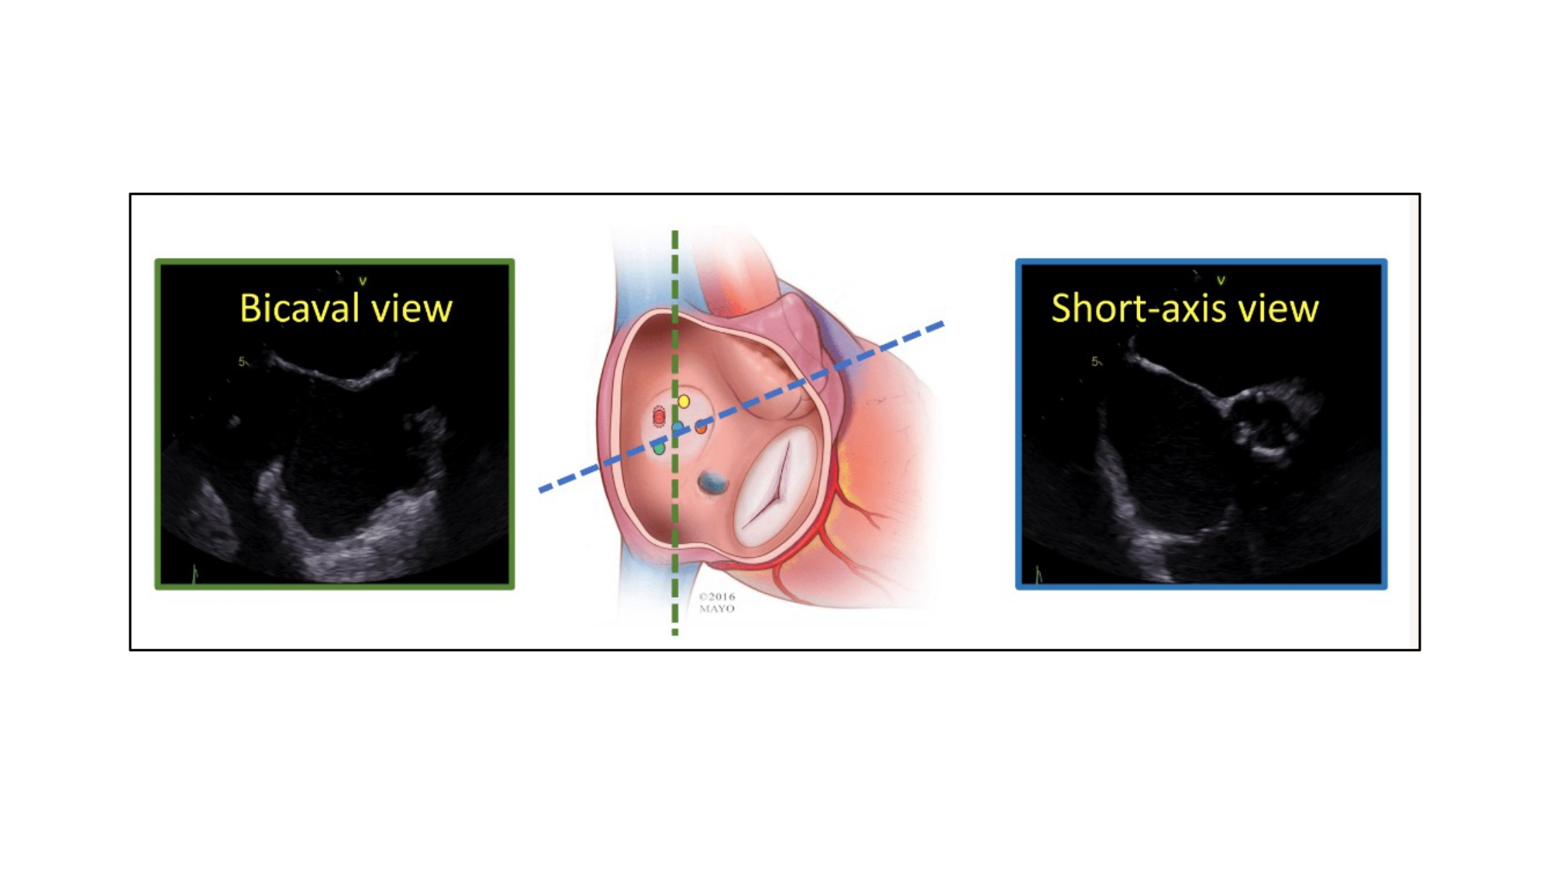

Echocardiographic, Fluoroscopic and CT guidance for transcatheter structural and coronary interventions
Figure 35
Orientation of bicaval and short-axis views for transseptal puncture. Transseptal puncture is typically guided by two transesophageal echocardiographic views:(1) short-axis and (2) bicaval views.
Horacio Medina de Chazal, Ali Zgheib, Angelo Quagliana, Michael Chetrit, Jean Buithieu, Giuseppe Martucci, Marco Spaziano, Ali Abualsaud, Ole de Baker, Laurence Campens, Pascal Theriault-Lauzier, Jeremy Ben-Shoshan, Nicolo Piazza
©2025 Europa Group - All rights reserved.

