Slide 1


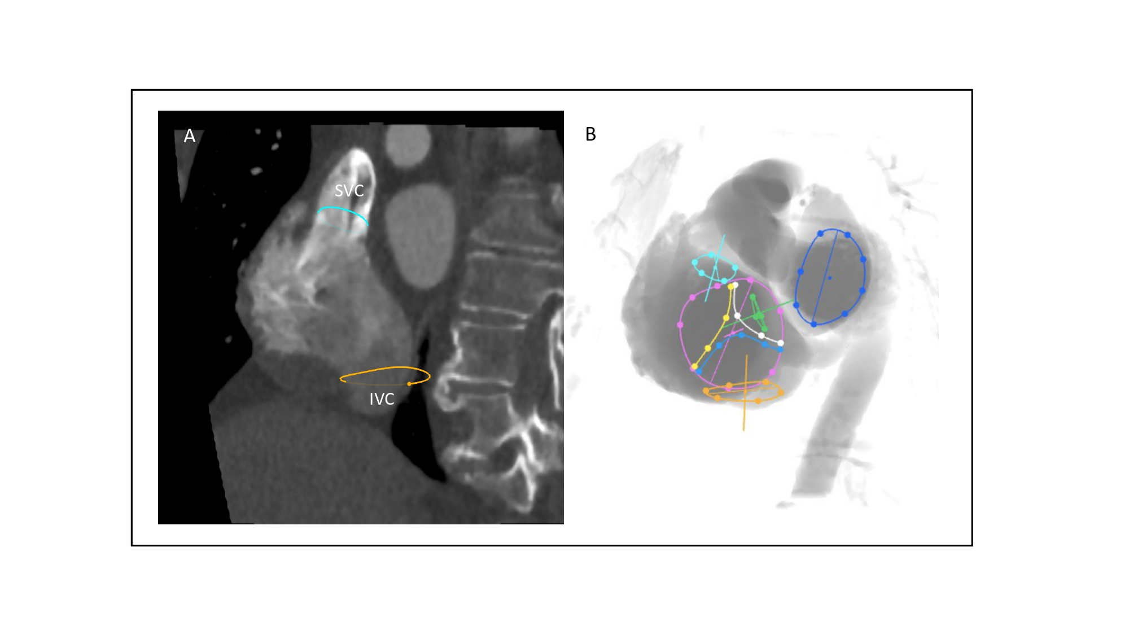

Echocardiographic, Fluoroscopic and CT guidance for
transcatheter structural and coronary interventions
Figure 40
Bicaval view. A) MSCT with multiplanar reconstruction transecting the en-face view of the atrial septum from superior to inferior vena cava. B) fluoroscopic simulation translating the multiplanar reconstruction line towards the tricuspid valve will result in a 1-chamber view of the right and left heart with the tricuspid (violet circle) and mitral (blue circle) valves in short-axis or en-face view (i.e., LAO CAUD, 1-chamber view of the right and left heart. MSCT – multislice computed tomography, turquoise circle: superior vena cava, orange circle: inferior vena cava, green line: atrial septum, white line (septal leaflet), yellow line (anterior leaflet), light blue line (posterior leaflet).
Horacio Medina de Chazal, Ali Zgheib, Angelo Quagliana, Michael Chetrit, Jean Buithieu, Giuseppe Martucci, Marco
Spaziano, Ali Abualsaud, Ole de Baker, Laurence Campens, Pascal Theriault-Lauzier, Jeremy Ben-Shoshan, Nicolo Piazza
©2025 Europa Group - All rights reserved.

