Slide 1


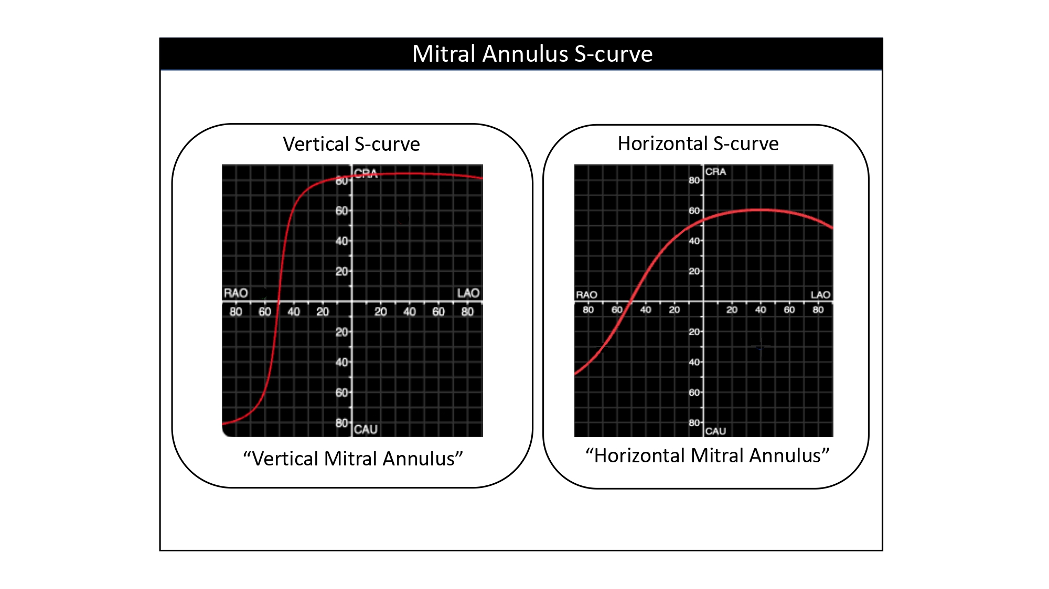

Echocardiographic, Fluoroscopic and CT guidance for transcatheter structural and coronary interventions
Figure 45
Mitral annulus S-curve. Geometric characteristics of the mitral annulus S-curve are the result of the mitral annulus orientation inside the chest. A “vertical” annulus generates an equally vertical slope of the S-curve, whereas a “horizontal” annulus results in a horizontal mitral annulus S-curve.
Horacio Medina de Chazal, Ali Zgheib, Angelo Quagliana, Michael Chetrit, Jean Buithieu, Giuseppe Martucci, Marco Spaziano, Ali Abualsaud, Ole de Baker, Laurence Campens, Pascal Theriault-Lauzier, Jeremy Ben-Shoshan, Nicolo Piazza
©2025 Europa Group - All rights reserved.

