Slide 1


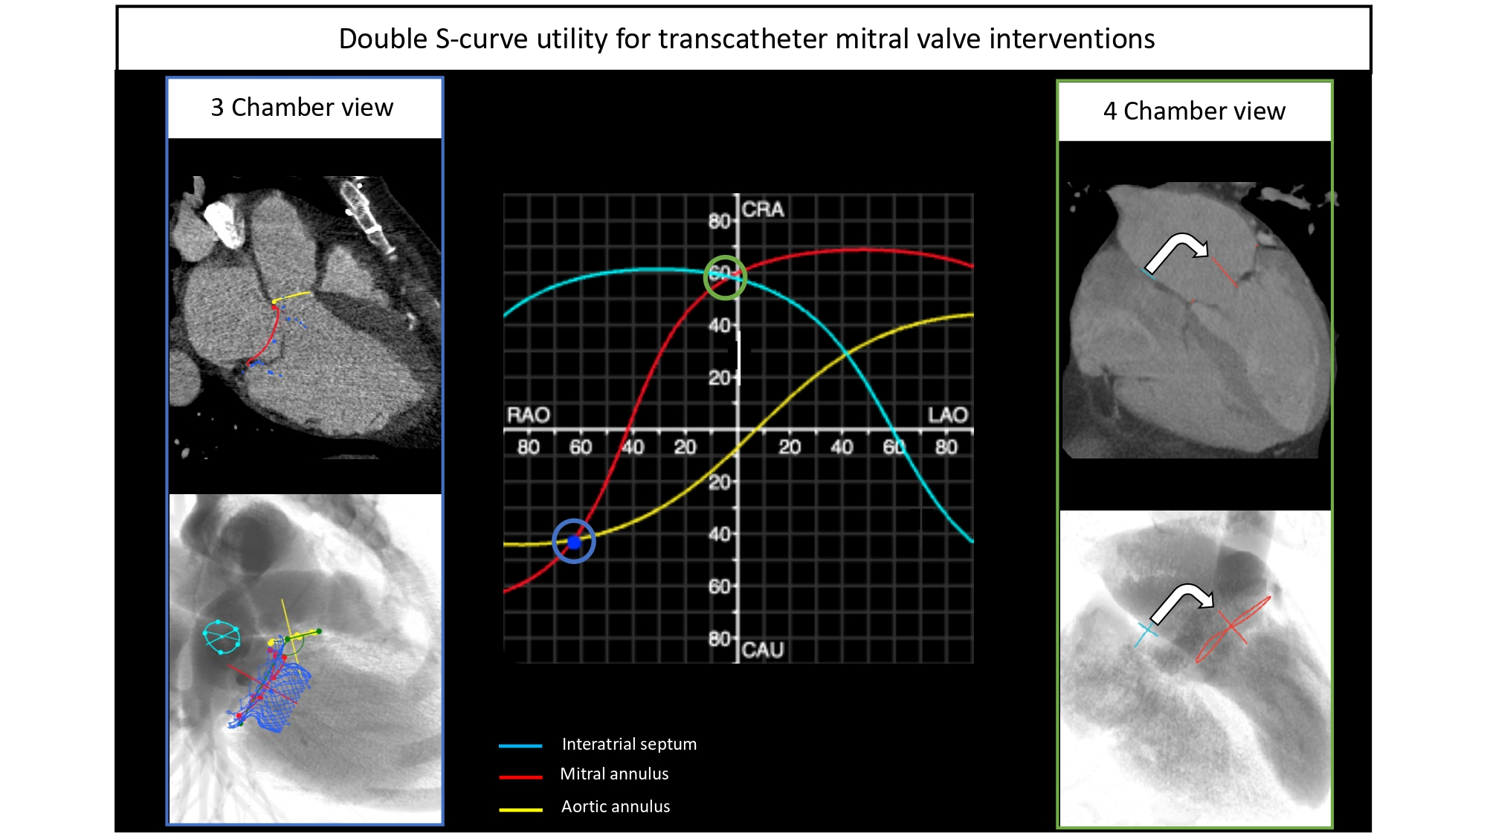

Echocardiographic, Fluoroscopic and CT guidance for transcatheter structural and coronary interventions
Figure 46
Double S-curve utility for transcatheter mitral valve interventions. The intersection of the mitral and aortic annulus S-curves defines the view (RAO CAU) where both structures are in plane allowing the operator to properly appreciate their attitudinal relationship. The blue column shows the aorto-mitral angle which is relevant for predicting the risk of LVOT obstruction during transcatheter mitral valve replacement. The green column shows a 4-chamber view where the interatrial septum and mitral annulus S-curves intersect and therefore are seen in plane. This view represents the optimal view for catheter navigation from the atrial septum into the mitral valve as it best reflects "the pathway" between both structures.
Horacio Medina de Chazal, Ali Zgheib, Angelo Quagliana, Michael Chetrit, Jean Buithieu, Giuseppe Martucci, Marco Spaziano, Ali Abualsaud, Ole de Baker, Laurence Campens, Pascal Theriault-Lauzier, Jeremy Ben-Shoshan, Nicolo Piazza
©2025 Europa Group - All rights reserved.

