Slide 1


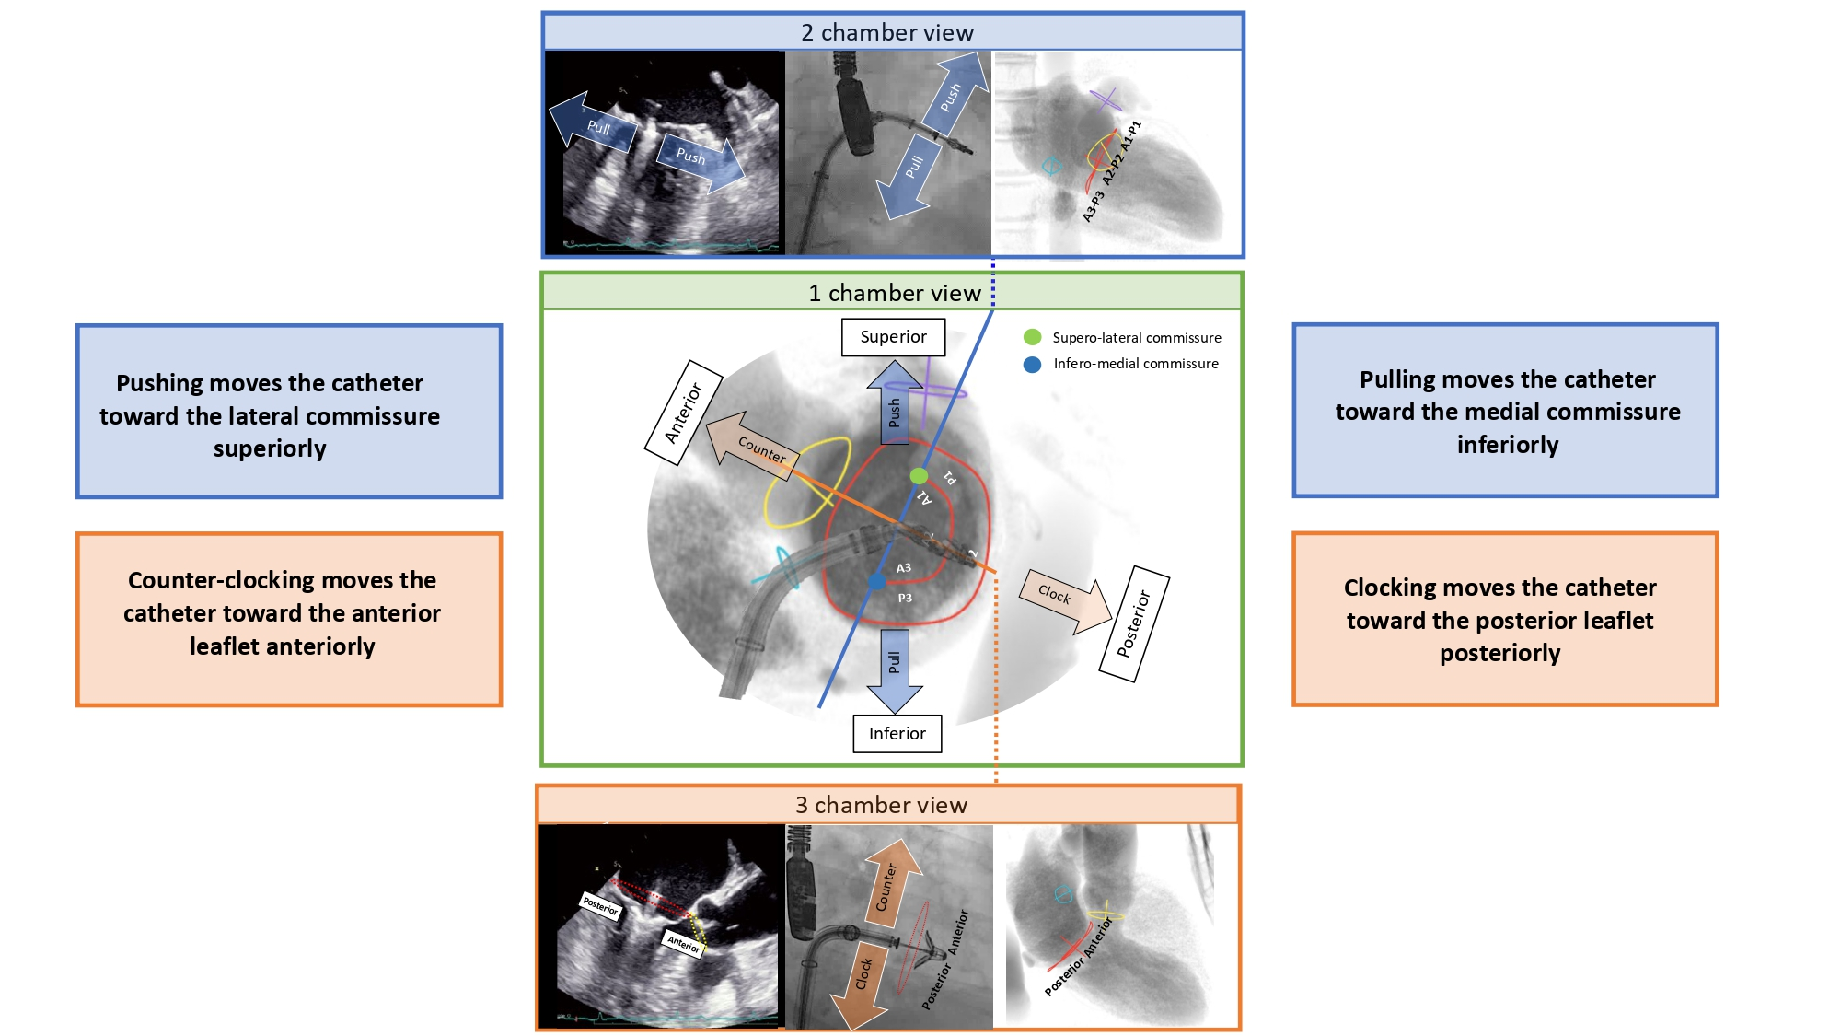

Echocardiographic, Fluoroscopic and CT guidance for transcatheter structural and coronary interventions
Figure 47
Catheter manipulation for transseptal transcatheter mitral valve procedures across different chamber views. Green panel: 1-chamber fluoroscopic view; mitral annulus (red circle), aortic annulus (yellow circle), interatrial septum (light blue circle) and left atrial appendage (violet circle) are simulated. Attitudinal orientation is indicated: superior (top), inferior (bottom), anterior (left-superior), and posterior (right-inferior). Blue and orange lines indicate the 2-chamber and 3-chamber views, respectively. A clip catheter demonstrates movement in all three panels. Blue central panel: mid esophageal TTE, fluoroscopy, and fluoroscopic simulation of the 2-chamber view. Orange central panel: mid-esophageal TTE, fluoroscopy, and fluoroscopic simulation of the 3-chamber view. Catheter movements are indicated by orange arrows for clockwise and counterclockwise rotation, and blue arrows for push and pull actions. Anterior: anterior mitral leaflet (A1-A2-A3); posterior: posterior mitral leaflet (P1-P2-P3).
Horacio Medina de Chazal, Ali Zgheib, Angelo Quagliana, Michael Chetrit, Jean Buithieu, Giuseppe Martucci, Marco Spaziano, Ali Abualsaud, Ole de Baker, Laurence Campens, Pascal Theriault-Lauzier, Jeremy Ben-Shoshan, Nicolo Piazza
©2025 Europa Group - All rights reserved.

