Slide 1


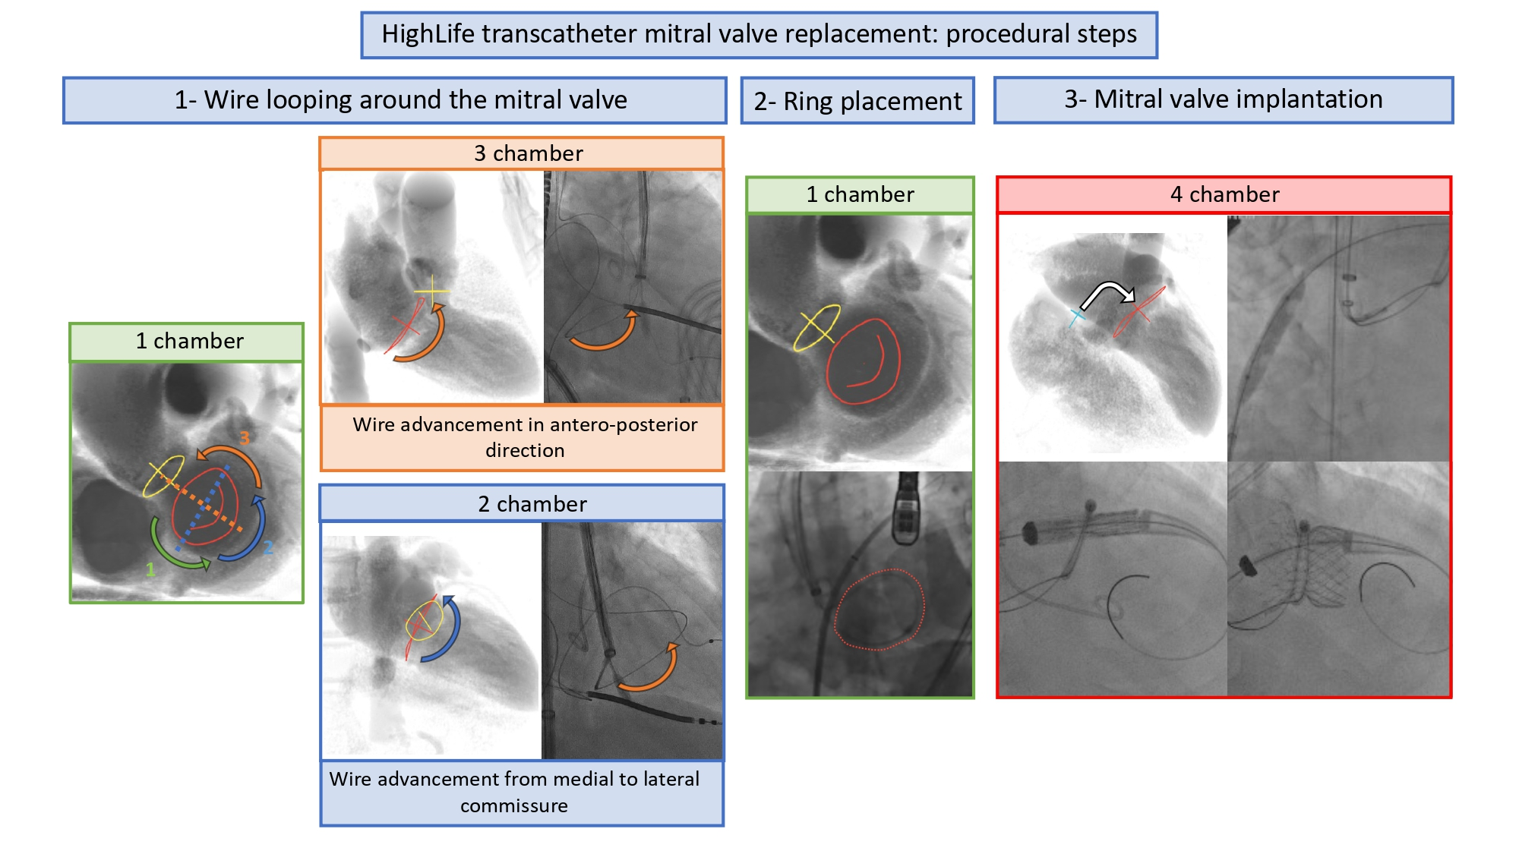

Echocardiographic, Fluoroscopic and CT guidance for transcatheter structural and coronary interventions
Figure 48
Fluoroscopic chamber views can facilitate performing more challenging interventions such as transcatheter mitral valve replacement. Step by step for a specific device implantation. 1- Wire looping around the mitral valve annulus requires a combination of 1-, 2-, and 3-chamber views while navigating with the wire around the mitral annulus. 2- Ring placement is best appreciated in 1-chamber view. 3- Prosthetic valve advancement from the interatrial septum into the mitral valve as well as mitral valve implantation is best appreciated in 4-chamber view.
Horacio Medina de Chazal, Ali Zgheib, Angelo Quagliana, Michael Chetrit, Jean Buithieu, Giuseppe Martucci, Marco Spaziano, Ali Abualsaud, Ole de Baker, Laurence Campens, Pascal Theriault-Lauzier, Jeremy Ben-Shoshan, Nicolo Piazza
©2025 Europa Group - All rights reserved.

